Slide 1
Stream 8 – Data and Law
Presenters
James Down – Brooke Weston Trust
Robert Della-Spina - Our Lady of Lourdes Catholic Multi-Academy Trust
Dr Jon Needham – Oasis Community Learning
Session Number

Slide 2
Making Data Work For You
James Down
Head of Safeguarding
Brooke Weston Trust
Session 8.1

Slide 3
It’s More Than a Tick in a Box…

Slide 4
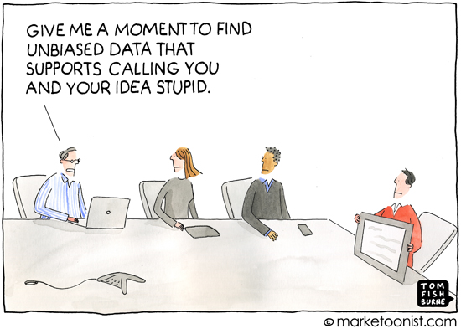
It’s More Than Just Influencing Others…

Slide 5
It’s More About This…

Slide 6
A Reflection from 2021…
What are the key safeguarding priorities for schools and MATS and how would you address these to improve outcomes for children and young people?

Slide 7
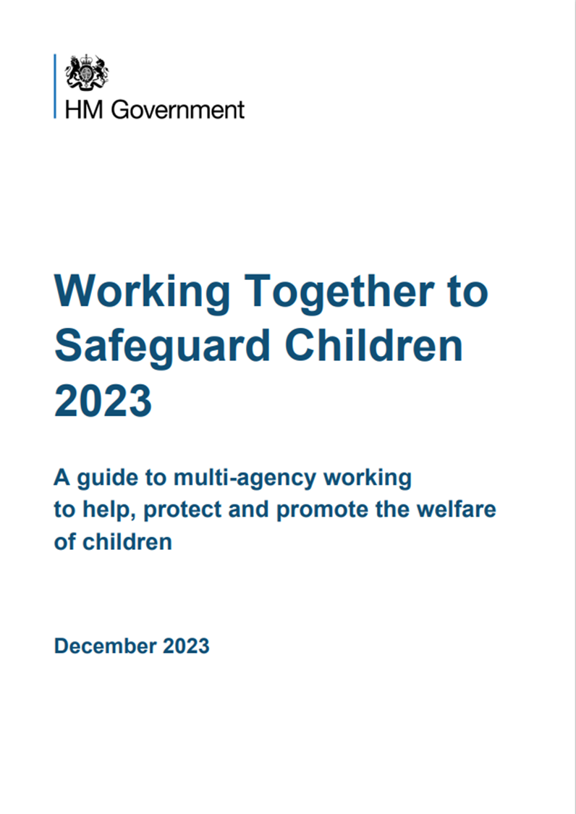
The Statutory Landscape

Slide 8
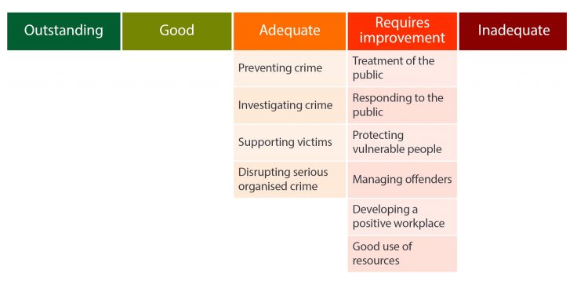
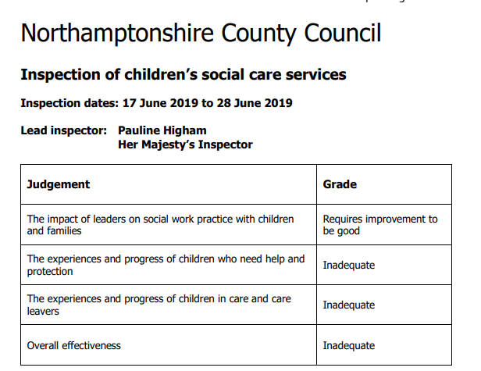
The Local Perspective

Slide 9
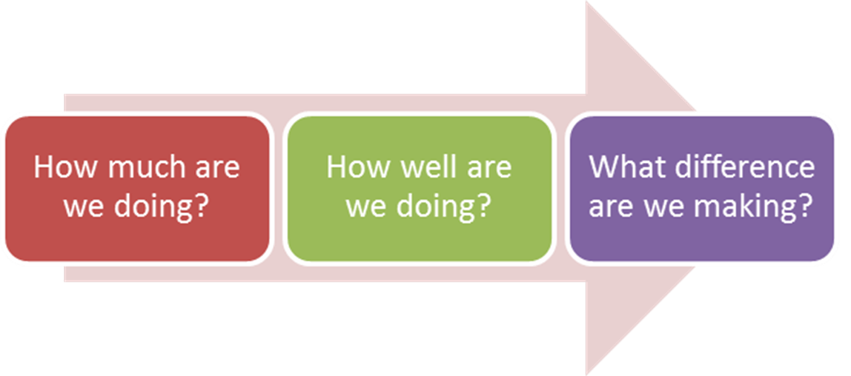
A Move Towards Impact
Trying Hard is Not Good Enough: How to Produce Measurable Improvements for Customers and Communities (Mark Friedman, 2005)

Slide 10
But What About Your School?
Focus Area | Quantity (How Much?) | Quality (How Well) | Impact (What Difference?)
Vulnerability | Mechanisms to identify and record | Total vulnerable and changes over time | Increase in lower tier need, decrease in higher tier need
Concerns | Number of concerns logged | Audit outcomes (% RAG) | Changes over time, links to curriculum inputs
Referrals | Total Referrals | % Met Threshold | % Step Down % Re-Referrals
Escalation | Total Escalation | % Successful | % Meeting Threshold (Future)
Training | Total Staff Trained | Increased knowledge or confidence | Increased reporting / improved referral quality
Staff Conduct | Total Low Level Concerns Total Allegations | Referred in timescale Total Unsubstantiated | Decrease in allegations Decline in concern types

Slide 11
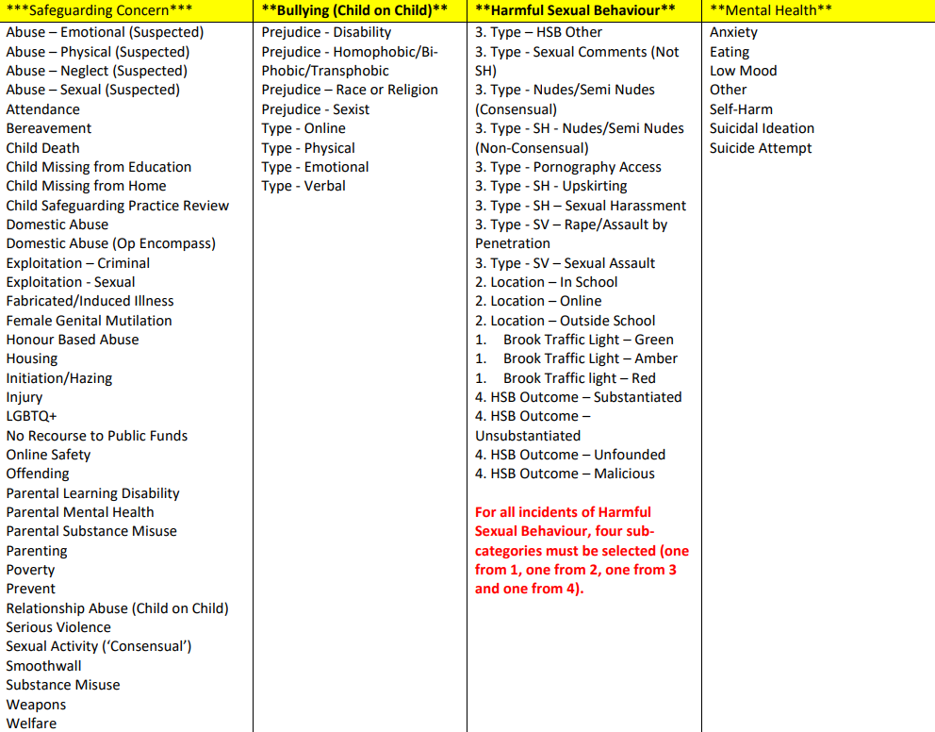
Standardise the Approach

Slide 12
Start with the end in mind…
I want to understand the nature, prevalence and extent of harmful sexual behaviour within my school:
Who is displaying/being subjected to HSB?
When are incidents occurring?
Where are incidents occurring?
What types of behaviours are being displayed?
Who is reporting the incidents?
What proportion of incidents would be considered age/stage appropriate?
What were the outcomes of any investigations that have taken place?

Slide 13
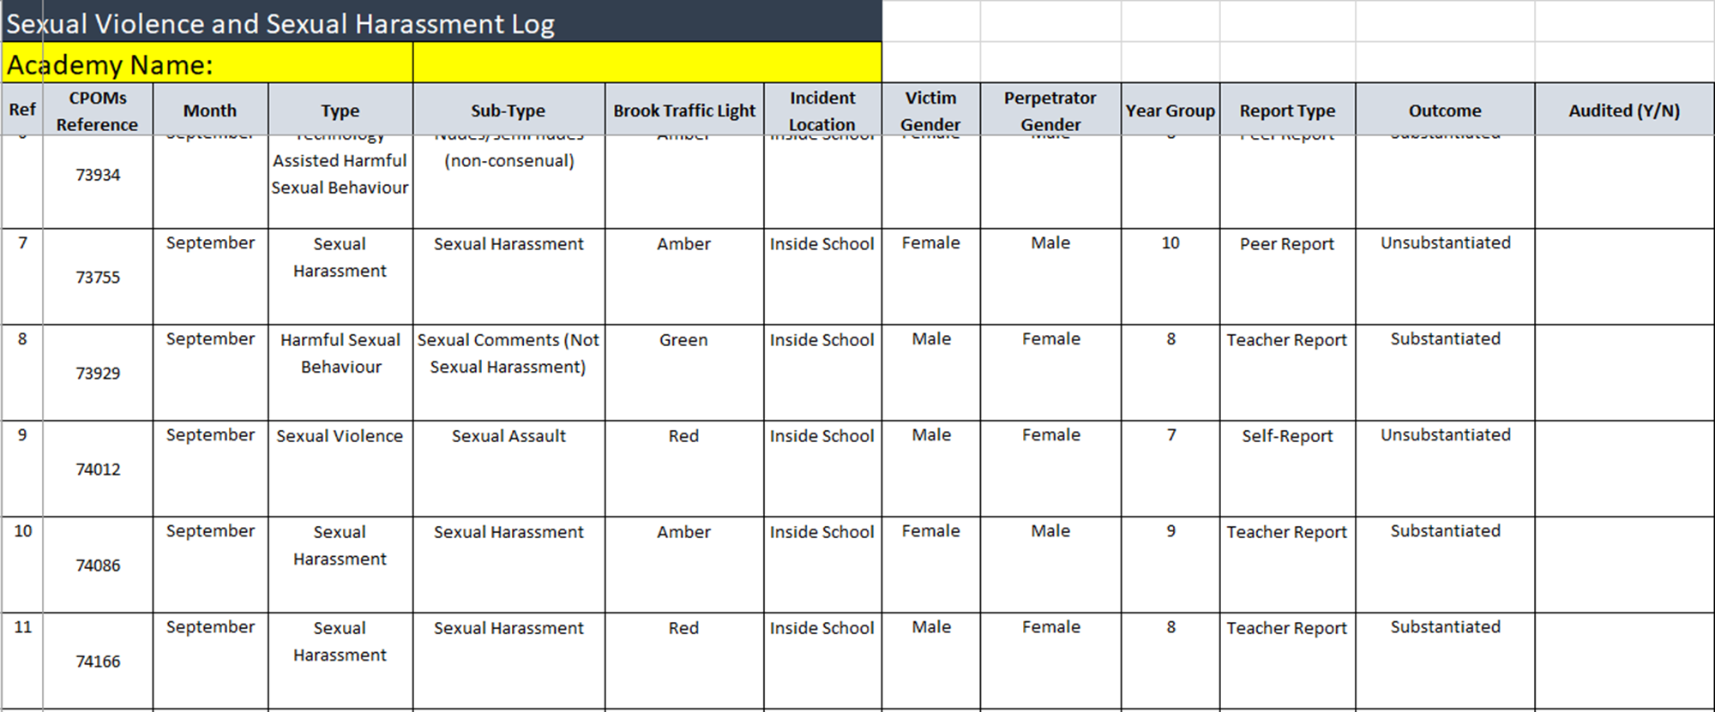
Start with the end in mind…

Slide 14
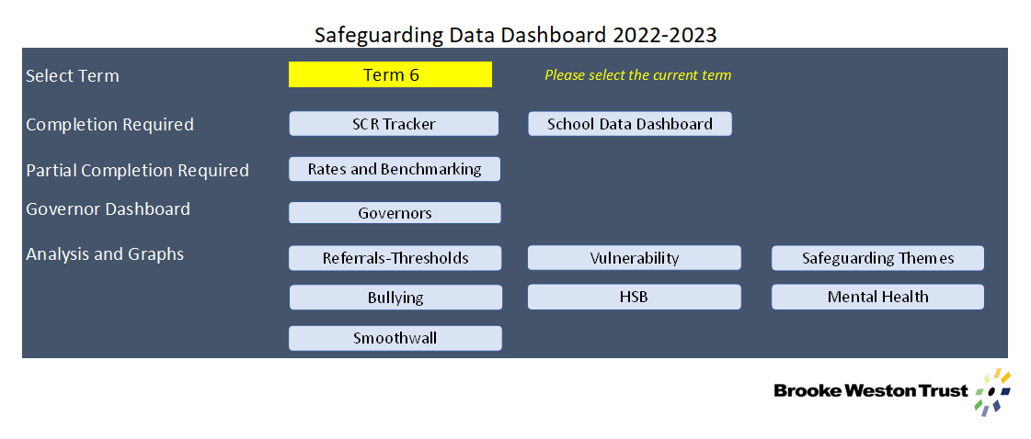
Develop Your Data Dashboard
The examples shown contains dummy data for illustration purposes only

Slide 15
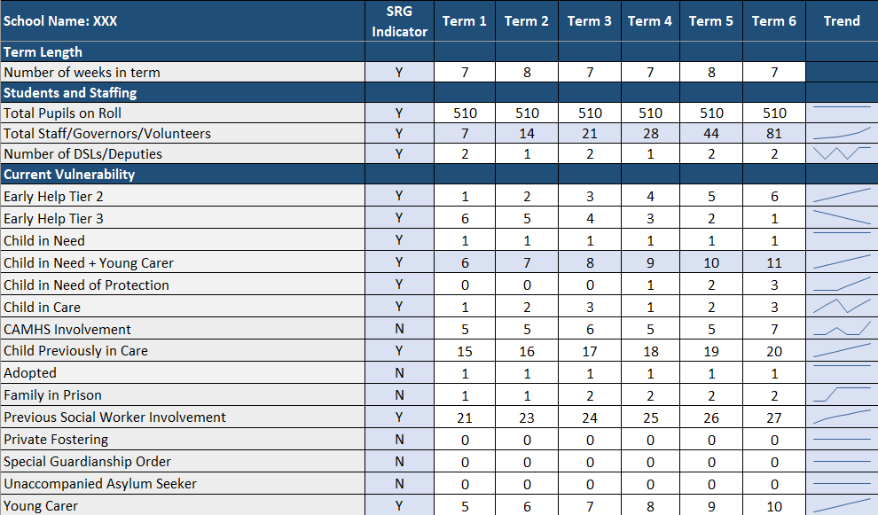
Key Indicators
Current Vulnerability

Slide 16
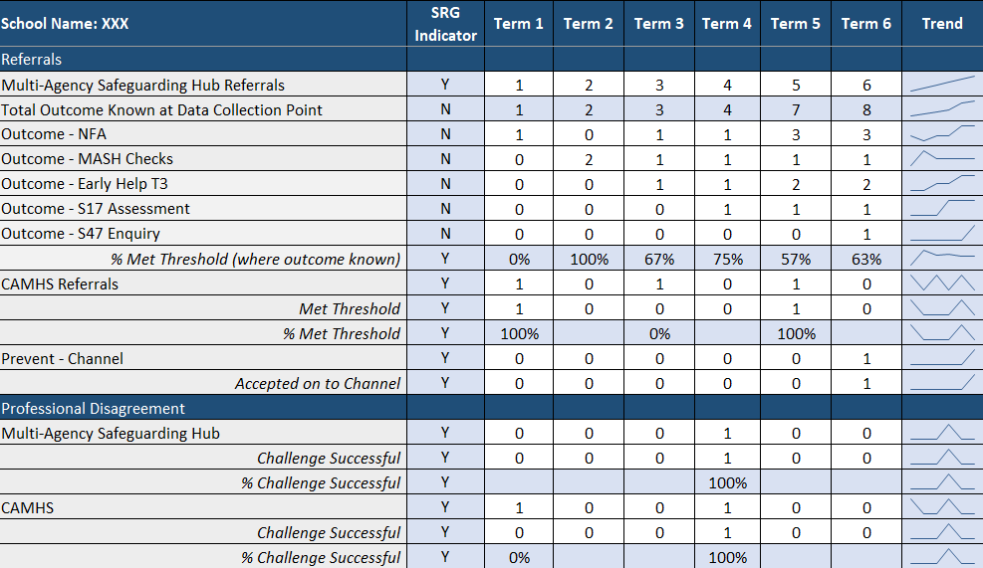
Moving Towards Impact
Referrals
Challenge

Slide 17
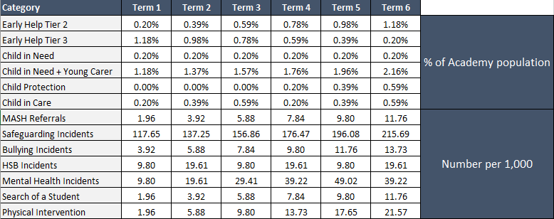
Making Data Meaningful

Slide 18
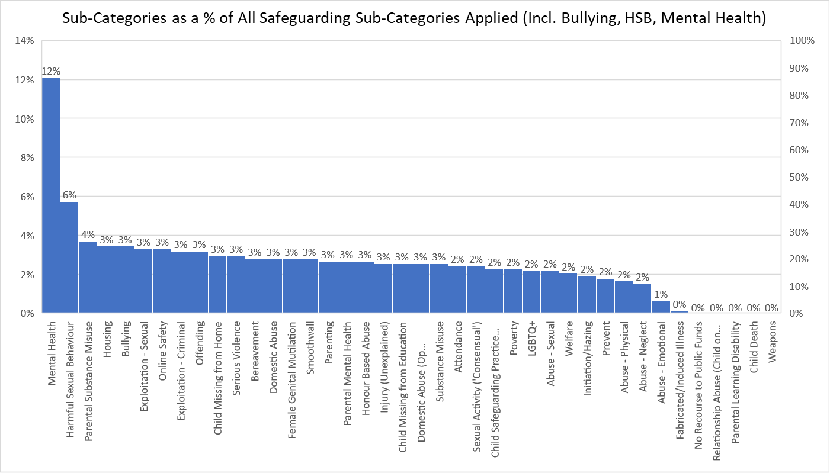
Making Data Meaningful

Slide 19
Interpretation and Nuances…
The data you pull out is only as good as the data you put in.
Know your data, community, school, curriculum, staff and students.
The more forensic you become, the more difficult it is to benchmark.
You can’t unknow what you know…

Slide 20
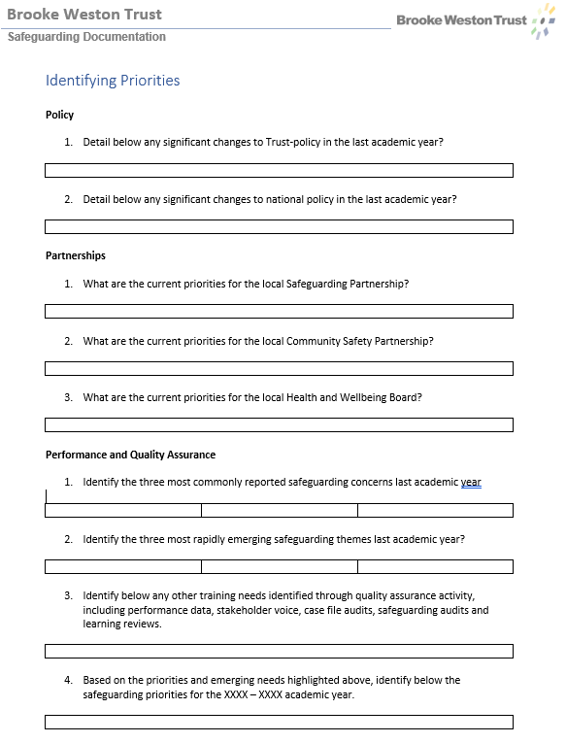
Identifying Your Priorities

Slide 21
Questions

Slide 22
Understanding Filtering and Monitoring
Robert della-Spina – Director of Performance and Standards
Our Lady of Lourdes Catholic Multi-Academy Trust
Session 8.2

Slide 23
Understanding Filtering and Monitoring
Aims:
To recognise the importance of filtering and monitoring systems in school
To identify your responsibilities in relation to filtering and monitoring
To know how to evidence compliance with Department for Education Standards in this area
Notes:
Briefly highlight learning aims
Warn delegates that we will be discussing themes that may be distressing, including suicide, so that they are able to take care of themselves, step outside if needed etc.

Slide 24
Understanding Filtering and Monitoring
This is not something new!
An extract from the Coroner’s Report read that:
I returned a conclusion of redacted with Frankie’s death more than minimally contributed to by the failures of Stepping Stone School:
To provide an effective e-security system as tasked to do so by the Department of Education
To ensure Frankie’s use of the iPad was monitored to confirm her safety.
To provide Frankie with supervision when not attending lessons despite having an Educational Health Care Plan in place.
A lack of robustness in their policies to remove age-inappropriate content that allowed Frankie to read stories on their platform on the day of her death featuring an act which she goes on to complete herself
Notes:
This is not something new - the first iteration of KCSIE in 2015 made reference to: Schools must ensure that children are safe from terrorist and extremist material when accessing the internet in schools. Schools should ensure that suitable filtering is in place. It is also important that schools teach pupils about online safety more generally.
Frankie Thomas died by suicide in September 2018. She was autistic and attended a special school. At home her internet usage was tightly controlled – devices had strong passwords and her parents supervised her when she was online. At school – she was able to use school iPads and her laptop with little oversight from staff and a filtering system that did not work. This meant she was able to access a website where people were posting short stories about self-harm and suicide. Tragically, the last of these stories that she read detailed the method she used to take her own life that afternoon.
The inquest concluded in 2021 and the coroner found several failings from the school, as well as with the robustness of the DFE’s policy in this area. After the verdict, Frankie’s parents continued to campaign for safeguarding policy and practice in this area to be strengthened which ultimately has led to the strengthened focus on this area within KCSIE 2023.

Slide 25
Understanding Filtering and Monitoring
KCSIE 2023 says that:
‘The DSL should take lead responsibility for…understanding the filtering and monitoring systems and processes in place’
‘All staff should receive appropriate safeguarding training which includes an understanding of the expectations, applicable roles and responsibilities in relation to filtering and monitoring’
‘It is essential that governing bodies and proprietors ensure appropriate filtering and monitoring systems are in place, they should be careful that “over blocking” does not lead to unreasonable restrictions as to what children can be taught’
‘Governing bodies and proprietors should ensure their school has appropriate filtering and monitoring systems in place and regularly review their effectiveness’

Slide 26
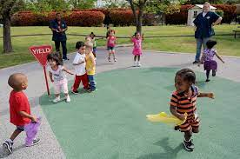
What is Filtering?
Understanding Filtering and Monitoring
What is Monitoring?
Blocks internet access to harmful and inappropriate content
Tracks the activity of users and alerts designated staff where this causes concern
Notes:
Simple analogy that filtering is a bit like the fence around the playground that stops the pupils accessing the dangers outside, monitoring is like the lunchtime staff who supervise the pupils and monitor that they don’t do anything of concern.
Filtering is about preventing access to harmful material including child sexual abuse content, sexual content such as pornography and terrorist content. This can also be configured to include other types of website such as gambling, games etc. An active and well managed filtering system is an important part of providing a safe environment for pupils to learn. No filtering system can be 100% effective. You need to understand the coverage of your filtering system, any limitations it has, and mitigate accordingly to minimise harm and meet your statutory requirements in KCSIE and the Prevent duty. An effective filtering system needs to block internet access to harmful sites and inappropriate content. It should not: • Unreasonably impact teaching and learning or school administration. • Restrict students from learning how to assess and manage risk themselves.
Monitoring is about tracking the activity of people whilst using devices that are covered by the software. This includes all keystrokes whether made on the internet or offline in Word/PowerPoint, emails etc. Monitoring user activity on school and college devices is an important part of providing a safe environment for children and staff. Unlike filtering, it does not stop users from accessing material through internet searches or software. Monitoring allows you to review user activity on school and college devices. For monitoring to be effective it must pick up incidents urgently, usually through alerts or observations, allowing you to take prompt action and record the outcome.

Slide 27
Understanding Filtering and Monitoring
KCSIE P.142: To support schools and colleges to meet this duty, the Department for Education has published filtering and monitoring standards which set out that schools and colleges should:
1. Identify and assign roles and responsibilities to manage filtering and monitoring systems
2. Review filtering and monitoring provision at least annually
3. Have a filtering system that blocks harmful and inappropriate content without unreasonably impacting teaching and learning, school administration or restricting students from learning how to assess and manage risk themselves
4. Have effective monitoring strategies in place that meet their safeguarding needs

Slide 28
Understanding Filtering and Monitoring
1. Identify and assign roles and responsibilities to manage your filtering and monitoring systems.
Clear roles and responsibilities are vital for delivering and maintaining effective filtering and monitoring systems. For example, consider:
Who is going to check the filtering system is working on a regular basis?
Who is going to receive the alerts and respond to them?
Who is going to block or unblock sites if required?
Who determines whether something needs to be blocked/unblocked?
It’s important that the right people are working together and using their professional expertise to make informed decisions.

Slide 29
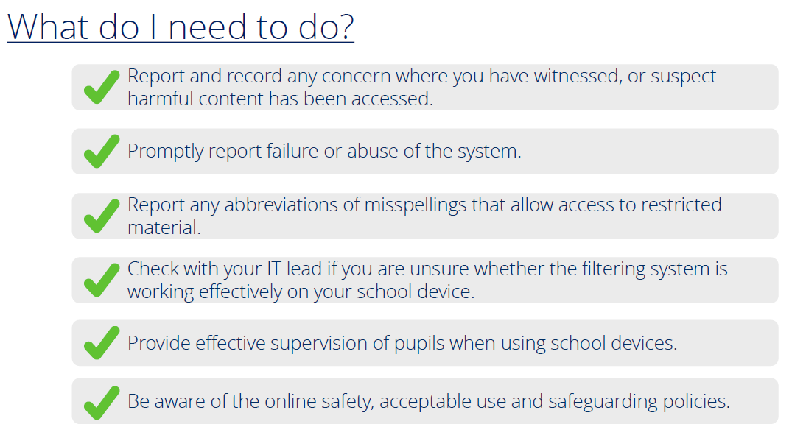
Understanding Filtering and Monitoring
1. Identify and assign roles and responsibilities to manage your filtering and monitoring systems.
Clear roles and responsibilities are vital for delivering and maintaining effective filtering and monitoring systems. For example, you might want your teaching staff to:

Slide 30
Understanding Filtering and Monitoring
2. Review filtering and monitoring provision at least annually
For filtering and monitoring to be effective it should meet the needs of your pupils and staff and reflect your specific use of technology while minimising potential harms. To understand and evaluate the changing needs and potential risks of your school or college, you should review your filtering and monitoring provision, at least annually. Consider:
Does your Trust have a process in place for schools to do this yet?
How does the review inform policy development?
How does the review inform staff training?
How do filtering and monitoring systems reduce the 4 ‘C’ risks in KCSIE?
How clear are staff on their responsibilities relating to filtering and monitoring?
How does provision work for ‘Bring Your Own’ devices or those used off-site?
How do the IT staff and safeguarding team work in partnership?
How is the review and actions communicated to Trust Board/Governors?
Notes:
Any review process should be documented with action points assigned to relevant staff so progress can then be assessed at the next review point.

Slide 31
Understanding Filtering and Monitoring
3. Have a filtering system that blocks harmful and inappropriate content without unreasonably impacting teaching and learning, school administration or restricting students from learning how to assess and manage risk themselves
4. Have effective monitoring strategies in place that meet their safeguarding needs
Notes:
No filtering system can be 100% effective. You need to understand the coverage of your filtering system, any limitations it has, and mitigate accordingly to minimise harm. This should be supported by clear processes for students and staff to report any inappropriate content alongside an online safety curriculum that educates pupils in this area at an age-appropriate level.
Monitoring user activity on school and college devices is an important part of providing a safe environment for children and staff. Monitoring allows you to review user activity on school and college devices. For monitoring to be effective it must pick up incidents urgently, usually through alerts or observations, allowing you to take prompt action and record the outcome. The school’s monitoring strategy should be informed by the filtering and monitoring review.
For this to work effectively we need systems that identify harmful activity, alert the right people, so that swift action can be taken to safeguard children.

Slide 32
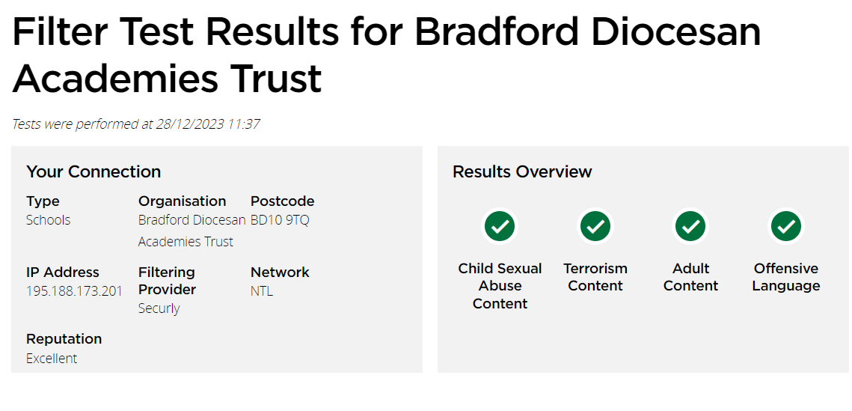
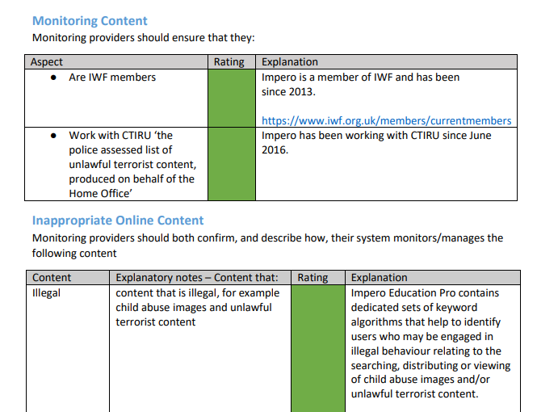
Understanding Filtering and Monitoring
Recommended Reading:
Keeping Children Safe in Education 2023
Meeting Digital and Technology Standards in Schools and Colleges
Prevent Duty Guidance
UK Safer Internet Centre: Appropriate Filtering Guide for Education
UK Safer Internet Centre: Appropriate Monitoring Guide for Education
SWGFL Test Filtering Website
UK Safer Internet Centre: Filtering and Monitoring Provider Self-Certifications
Notes:
Highlight the www.testfiltering.com website from SWGFL and the UKSIC self-certifications as these may provide DSLs with some evidence that their school’s filtering and monitoring software systems are effective based on the UKSIC checklist.

Slide 33
Understanding Filtering and Monitoring
Review and Audit
Safeguarding Response
Filtering and Monitoring is a Core Element of Safeguarding
Policies and Processes
Staff Training
Notes:
In summary – filtering and monitoring is a core element of the online safety strategy that fits into the wider safeguarding culture of the school. As a DSL it is important that you ensure that these key things are in place:
- Policies and processes that are clear for all stakeholders so everyone knows what their role and responsibility is in filtering and monitoring
- Training for staff to ensure they understand these responsibilities
- Systems that enable an appropriate safeguarding response when concerns arise
- A programme of review that assesses the risk in your setting and how your filtering and monitoring systems reduce these risks and safeguard pupils

Slide 34
Questions

Slide 35
The Online-Safety Bill: implications for academies
Dr Jon Needham
National Director of Safeguarding
Oasis Education
Session Number: 8.3

Slide 36
On-Line Safety Bill
Royal Assent October 2023
Ofcom named as the formal regulator
Purpose
Prevention of on-line platforms hosting harmful or illegal content
Stop child sex abuse material on-line
Establish age verification to avoid inappropriate age access

Slide 37
The Online Safety Act
The new rules apply to 3 groups/services:
‘User to User’ services: where users can create and share content, or interact with each other ;
‘Search Services’: where users can search other websites or databases or
‘General Users’: where an individual or business publish or display pornographic content.

Slide 38
New Criminal Offences:
The false communications offence: aimed at protecting individuals from any communications where the sender intended to cause harm by sending something knowingly false.
The threatening communications offence: to capture communications that convey a threat of serious harm, such as grievous bodily harm or rape.
Flashing offence: aimed at stopping epilepsy trolling (Zach’s Law).
Assistance offence: an offence criminalising the assisting or encouraging of self-harm online.

Slide 39
Online safety bill & schools
The act is designed to ensure that children under the age of 13 cannot access social media platforms.
The act does not remove the current safeguarding duties placed upon schools. These duties are not being transferred to tech companies.
The designated safeguarding lead should take lead responsibility for safeguarding and child protection (including online safety and understanding the filtering and monitoring systems and processes in place).

Slide 40
On-line Safety & the School
It is essential that children are safeguarded from potentially harmful and inappropriate online material. An effective whole school and college approach to online safety empowers a school or college to protect and educate pupils, students, and staff in their use of technology and establishes mechanisms to identify, intervene in, and escalate any concerns where appropriate. (KCSIE ‘23 para 135)
Governing bodies should ensure online safety is a running and interrelated theme their whole school approach to safeguarding and related policies and procedures. This will include:
How online safety is reflected as required in all relevant policies,
Delivered in the curriculum, any teacher training,
Included in the role and responsibilities of the designated safeguarding lead (and deputies),
How parental engagement is assured.

Slide 41
Filtering & Monitoring
Governing bodies and proprietors should :
Ensure their school or college has appropriate filtering and monitoring systems in place and regularly review their effectiveness.
Consider access the IT system along with the proportionality of costs versus safeguarding risks.
identify and assign roles and responsibilities to manage filtering and monitoring systems:
review filtering and monitoring provision at least annually.
block harmful and inappropriate content without unreasonably impacting teaching and learning.
have effective monitoring strategies in place that meet their safeguarding needs

Slide 42
Questions to ask yourself
Is filtering & monitoring explicit in your Job Description?
(KCSIE Appendix C -pg 165)
How do you assure your governors/trustees that your monitoring systems are effective?
How do you engage your students & parents?
How do you ensure the balance between the right to learn and censorship?
How do you identify ‘risk’?
How do you identify the additionally vulnerable?
How do you address on-line disadvantage?

Slide 43
Questions

