Slide 1
Stream 7 - Culture
Presenters
Alana Watson – Archway Learning Trust
Ben Straker – Diocese of Hereford Multi-Acdemy Trust
Keri Standen – Yorkshire Causeway School Trust
Session Number

Slide 2
Safeguarding across different cultures.
Alana Watson
Trust Lead for Safeguarding
Archway Learning Trust
Session Number: 7.1

Slide 3
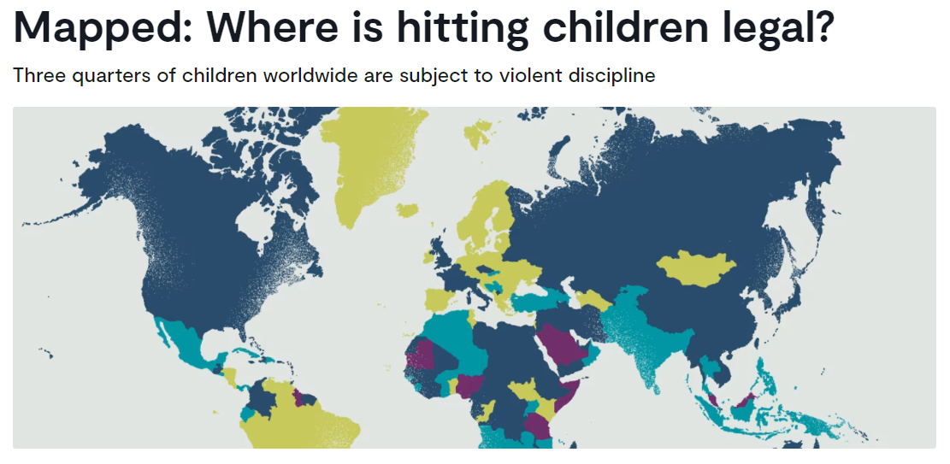
Taking the helicopter view

Slide 4
NSPCC – Learning from case reviews
Published case reviews highlight that professionals sometimes lack the knowledge and confidence to work with families from different cultures and religions.
A lack of understanding of the religions and cultural context of families can lead to professionals overlooking situations that may put children at risk.

Slide 5
Certain practices linked to culture, faith or belief may put children at risk of abuse.
Staff working in schools must be well supported by designated safeguarding leaders to identify and appropriately respond to any child protection concerns linked to culture, faith and belief.

Slide 6
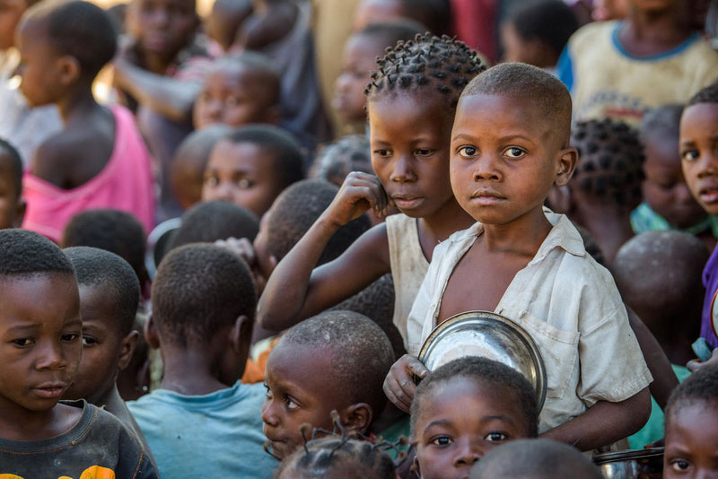
Scenario 1
How do we support children and families from the Democratic Republic of Congo to understand that physical chastisement with implements is illegal in England?

Slide 7
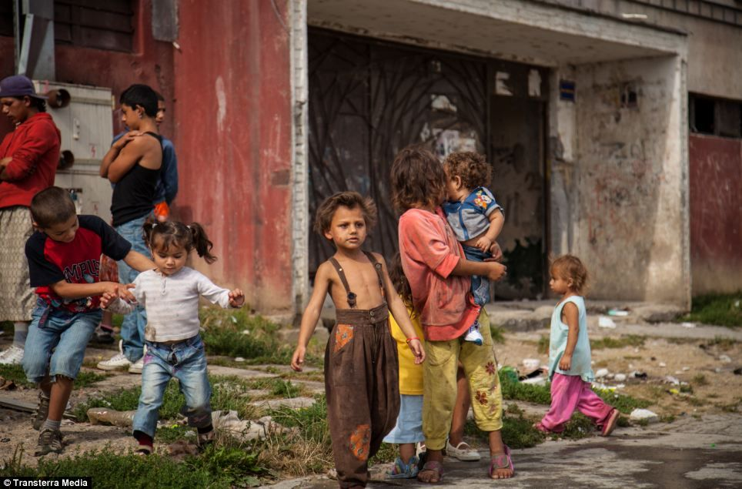
Scenario 2
How do we support Roma children and families from Slovakia to understand expectations of children’s personal hygiene in England?

Slide 8
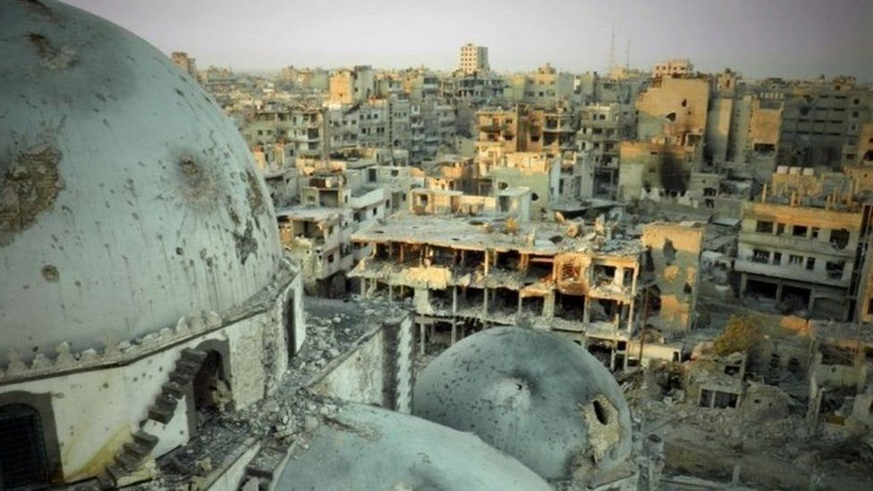
Scenario 3
How do we support children and families from Syria who have been relocated in England as part of Home Office resettlement?

Slide 9
Challenging parenting styles
Where a cultural practice or belief system is harmful to children we must address this to mitigate the risk it poses.
Practitioners can feel a sense of fear regarding been labelled as racist.
Knowledge and understanding of culture and faith is critical. Culture and faith should not be used as an excuse to abuse and must never take precedence over children’s rights.

Slide 10
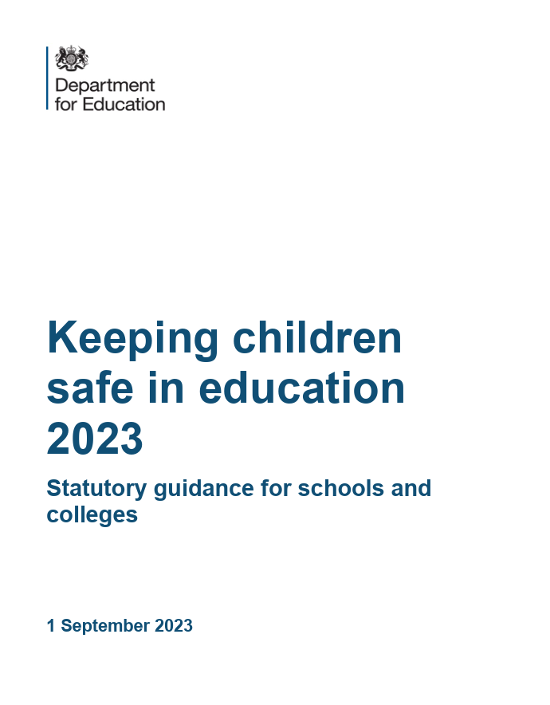
Using statutory safeguarding guidance is essential in maintaining focus in addressing safeguarding issues across different cultures and faiths.
What can be commonplace in many other countries may be in direct opposition to statutory safeguarding guidance in England.

Slide 11
Maintaining a baseline of what is acceptable parenting and what is harmful to children is critical.
You will not be lost in the debate about culture or religion, nor allow these powerful subjects to supersede the safety of children if you use statutory guidance to help focus your decision making.

Slide 12
Professionals want to be respectful of families cultural and religious practices but the desire to be culturally sensitive can result in professionals accepting lower standards of care.

Slide 13
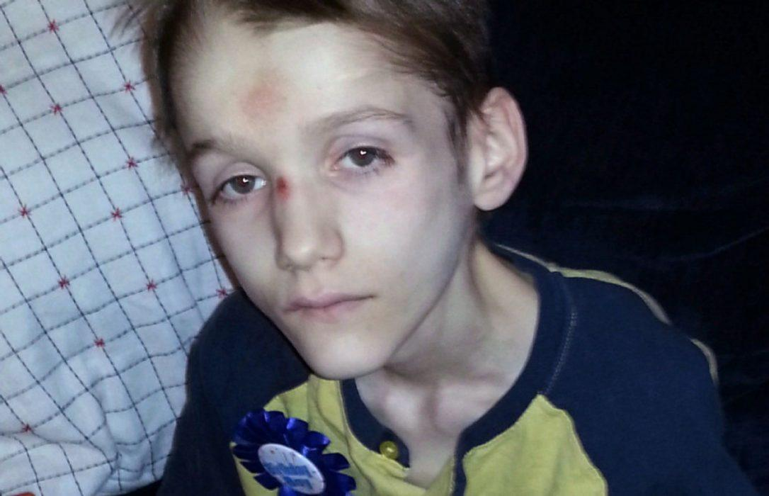
Child deaths linked to faith and belief

Slide 14
What can we do?
Explore school demographics.
Explore community demographics.
Deliver training and development to your staff teams.

Slide 15
Questions

Slide 16
Working with Gypsy, Roma and Traveller communities
Ben Straker
Director of Safeguarding and Inclusion DHMAT
Session 7.2

Slide 17
Aims of the session
Increase understanding of:
Gypsy, Roma and Traveller ethnicity, language and culture in the UK
Implications of historical, and current, community experience for the provision of public services
Mitigation against potential barriers to inclusion and equality

Slide 18
Note of caution
Terminology and categorisation can lead to unhelpful generalisations.
Due to the focus on inequalities experienced by some Travelling people, there is a danger of misapplying a ‘victim’ narrative that can unhelpful and offensive.
What do we mean by ‘community’ ?

Slide 19
Key considerations
Gypsy, Roma and Traveller (GRT) is an umbrella term that covers a wide range of groups, families and individuals, each with their own distinct histories, cultures and beliefs.
Gypsies, Roma and Travellers face social and economic discrimination and oppression from state bureaucracies across mainland Europe and in the UK.
Good practice requires agencies to acknowledge the impact of oppression, and to take proactive steps to meaningfully engage with Gypsy, Roma and Traveller communities, collectively and individually.

Slide 20
A broad overview of ethnic, linguistic and cultural groups of Travelling people in the UK
Gypsy, Roma, Traveller
Romani Gypsies
Irish Travellers
New Travellers
Circus People
Boat People
Fairground and Show People
Scottish Travellers
Welsh Travellers
Roma

Slide 21
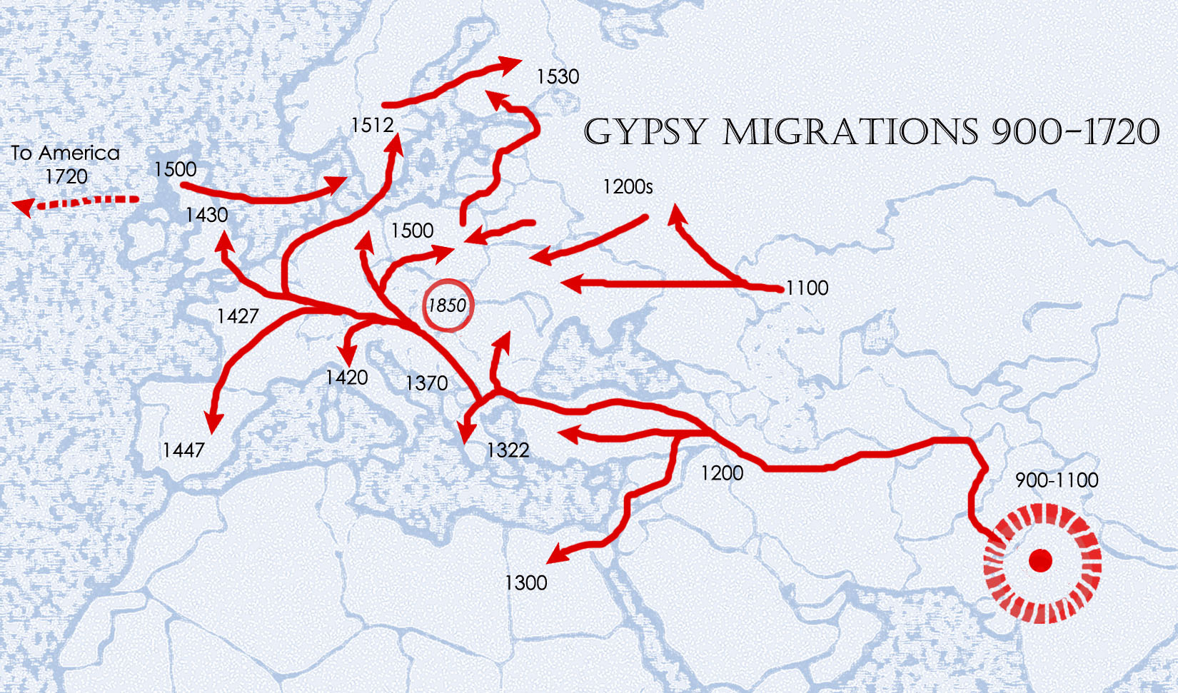

Slide 22
Brief overview of legislation relating to nomadic people in England and the UK
The Egyptians Act (1530) Banning immigration
Act for the Punishment of vagabonds, calling themselves Egyptians (1562) Death and dispossession including for those who offered protection
Settlement Act (1652) Forced emigration
Enclosure Act (1857) Of land
Commons Act, (1876) Of Land
Moveable Dwellings Bill (1888) Permitting authorities to enter a trailer to check for sanitation, health, and moral irregularities
Caravan Sites and Control of Development Act (1960) Regulating Campsite provision
Caravan Sites Act (1968) Legal duty to provide social accommodation
Race Relations Act (1976) recognition of ethnicity of Romany Gypsies since 1989, Irish Travellers since 2000, Scottish since 2009
Criminal Justice and Public Order Act (1994) Repealed the duty to provide social accommodation

Slide 23
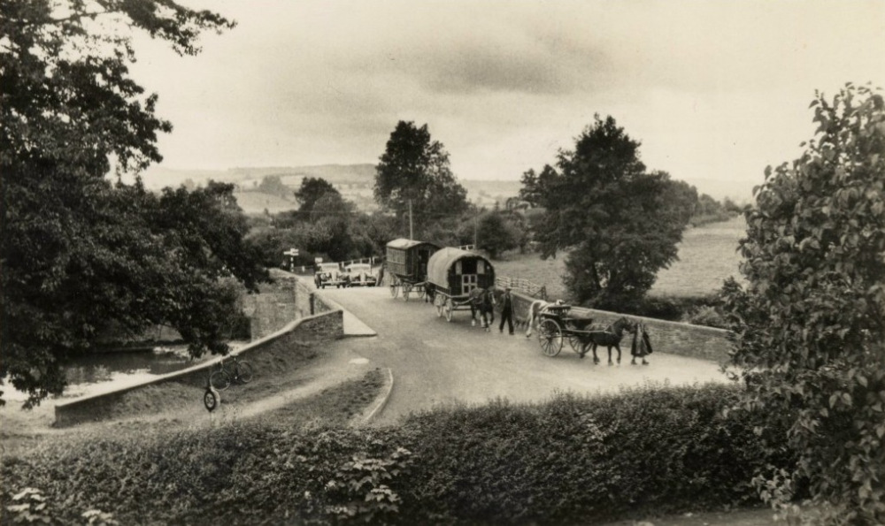

Slide 24
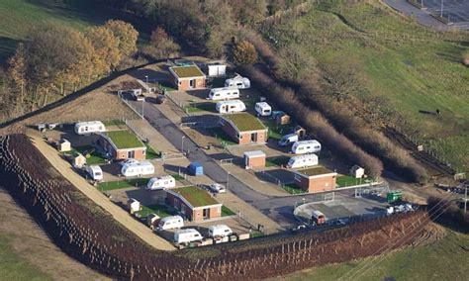

Slide 25
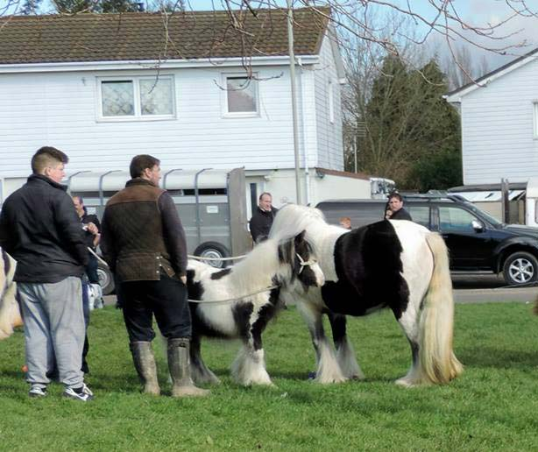

Slide 26
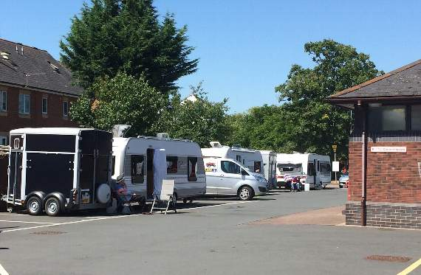

Slide 27
Hostility and harassment
A survey of GRT people undertaken by the Traveller Movement 2016 found that 98% of respondents had experienced discrimination and 81% hate crime or hate speech.
The survey also reported that 77% hide their ethnicity as a defence mechanism against discrimination and persecution and as a means of securing employment.

Slide 28
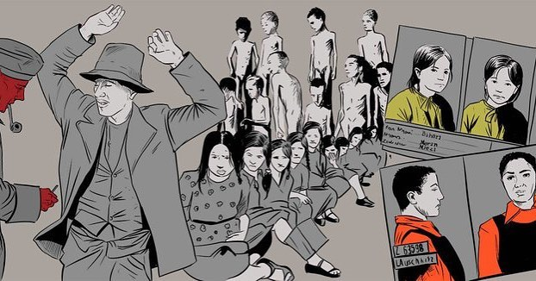

Slide 29
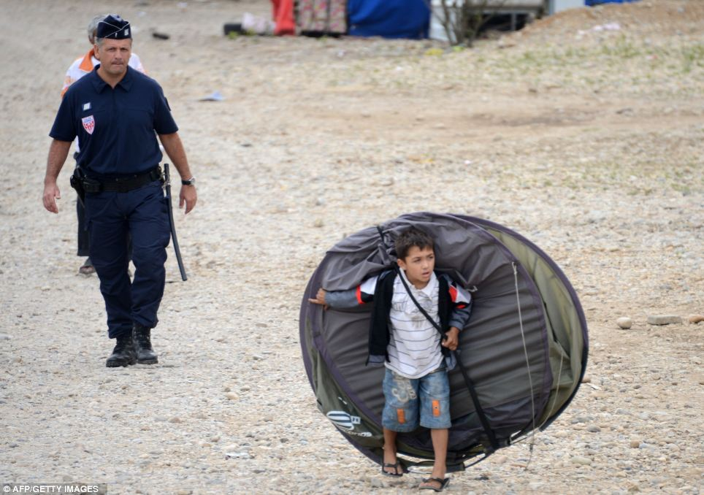

Slide 30
Reasons for under-reporting of GRT ethnicity
Some families do not want to tick a box saying Gypsy – they do not like this terminology;
They tick a box that says White British as they consider themselves both White British and Romany/Traveller;
They have paperwork completed on their behalf, and the question of ethnicity is not raised;
It is not an engrained part of professional culture to ask apparently ‘White British’ families additional information about their ethnicity and home language.
Families are fearful that sharing their ethnicity will lead to discrimination.

Slide 31
Equality challenge
As a group subject to the label “hard to reach” Gypsy, Roma and Traveller people have become further marginalised.
Experiences of trans-generational discrimination indicate that Gypsy, Roma and Traveller people require more support from services.
Being labelled as a marginal group suggests that ‘standard’ practices of professional services might exclude them.

Slide 32
Cultural Competence
“The capacity of individuals and organisations to be aware of, have respect for and to work effectively with people from ethnic, cultural, political, economic and religious backgrounds that are different from their own whilst also being aware of how their own background and culture influences their perceptions of and interactions with others.” Gilligan, 2013

Slide 33
Good practice in engaging Romany and Traveller families
Reflect on your own attitudes and values and avoid assumptions.
Acknowledge the context of your involvement.
Be clear about the specific concerns and what needs to change.
Listen, engage and form relationships.
Help families understand professional processes.
Understand cultural aspects of communication.
Understand the limitation of existing assessment tools

Slide 34
How to elicit understanding
How do you define yourself and what words do you use?
What does being Gypsy/Roma/Traveller mean to you?
What, if any, are the main differences between your culture and the majority culture?
What does the experience of living on a campsite/by the roadside/in a house/in the UK mean to you as a Gypsy, Roma and Traveller?
What is a typical day like for you?
In what way do your family and community support you?
What is the hardest thing about being a Gypsy, Roma or Traveller?
If you could change three things about your current situation, what would you change?

Slide 35
Information and further resources
The National Association of Teachers of Travellers folded in recent years. This is a sad loss.
Friends Families and Travellers https://www.gypsy-traveller.org/ is an excellent site with loads about history and culture. I recommend reading some of their cultural awareness resources. Here are some learning resources that they have assembled.
https://www.gypsy-traveller.org/heritage/celebrating-gypsy-roma-and-traveller-history-month/
https://www.travellerstimes.org.uk/ is another excellent resource. There is a young Travellers section too.
https://www.leedsgate.co.uk/ Leeds Gypsy and Traveller exchange is alive and well.
https://travellermovement.org.uk/ This organisation is strategic/policy driven.
I recommend this channel 5 series to anyone https://www.channel5.com/show/gypsy-kids-our-secret-world/
Also on BBC 4
https://www.bbc.co.uk/programmes/p070k8dg A Very British History

Slide 36
The Traveller Movement - A Good Practice Guide
for improving outcomes for Gypsy, Roma and Traveller Children in education
April 2019

Slide 37
Gilligan, P(2013) exploring neglected elements of cultural competence in social work practice: promoting and developing understanding of religion, belief and culture. University of Bradford
Research in practice (2015) Confident practice with cultural diversity www.rip.org.uk
The Fragility of Professional Competence (Herefordshire professionals contributed to this research)
http://www.errc.org/uploads/upload_en/file/the-fragility-of-professional-competence-january-2018.pdf
Allen, D & Adams, P (2013) Social work with Gypsy, Roma and Traveller children: good practice guide. BAAF
Allen, D (2016) ‘Its in their Culture’: Working with automatic prejudice towards Gypsies, Roma and Travellers in Care Proceedings’. http://usir.salford.ac.uk/id/eprint/39118/2/Seen%20and%20Heard%20Dan%20Allen%20DRAFT%206%20May%202016[1].pdf
Cemlyn, S & Allen, D (2016) ‘Outreach: Care experiences amongst Gypsy/Traveller families', in: Williams, C & Graham, M (eds.), Social work in a diverse society: Transformative practice with black and ethnic minority individuals and communities, Bristol: Policy Press pp 161-180
Allen, D (2015), 'Protecting the cultural identity of Gypsy, Roma and Traveller children living in the public care system', Today's Children’, Tomorrows Parents, 40-41(1), pp. 122-139.
Greenfields, M & Allen, D (eds) 2015, 'The well-being of Gypsy, Traveller and Roma Children and Families - investing in the future by supporting families experiencing migration, exclusion, racism and stress', Todays children Tomorrows Parents, 40-41(1)
A brief fact sheet - https://www.travellerstimes.org.uk/sites/default/files/paragraphs/filelink/Gypsies%20and%20Travellers%20Lifestyle%20History%20and%20Culture%20FAQs.pdf
The exponential rise in numbers of GRT children in care
https://www.travellerstimes.org.uk/features/gypsy-roma-and-traveller-children-care-tt-investigation

Slide 38
Questions

Slide 39
The adultification of a generation
Keri Standen
Trust Safeguarding Lead
Yorkshire Causeway Schools Trust
Session 7.3

Slide 40
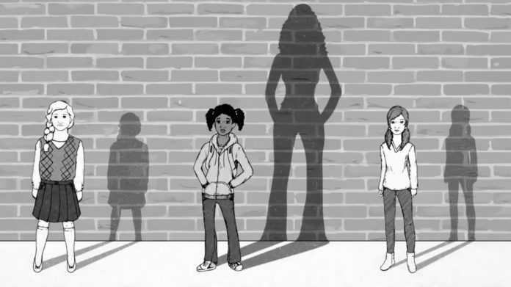
Adultification – understanding context
What is your understanding of adultification?
In what circumstances do you thinking children might experience adultification?

Slide 41
Adultification – definition
Davis and Marsh (2020) define adultification as:
‘The concept of adultification is when notions of innocence and vulnerability are not afforded to certain children. This is determined by people and institutions who hold power over them.
When adultification occurs outside of the home it is always founded within discrimination and bias. There are various definitions of adultification, all relate to a child’s personal characteristics, socio-economic influences and/or lived experiences.
Regardless of the context in which adultification take place, the impact results in children’s rights being either diminished or not upheld.’

Slide 42
Adultification in different context
Socio economic disadvantage
Domestic Abuse
Transphobia
Homelessness
Unaccompanied Minors
Children In the care system

Slide 43
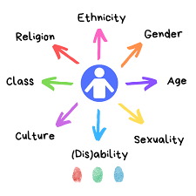
Intersectionality
Children and young people, like all of us, have diverse identities. As well as experiencing prejudice or bias related to their ethnic background for instance, they might experience challenges relating to other parts of their identity, such as:
gender, sexuality, disability
mental ill health
having been in local authority care
where you live, how much money you have, and your access to education.
The way these aspects interact is known as intersectionality.
Notes:
Kimberlé Crenshaw (1991) identified that a person’s interactions with the world are not just solely based on one aspect of their identity but are layered and multifaceted; interactions in which racism, sexism, ableism, classism and homophobia are experienced simultaneously.
For example, a child can experience racism and sexism at the same time. Practitioners’ biases and perceptions of the way different characteristics interact can affect the way they assess the risk to a child. This in turn will have an impact on the support that is put in place to help keep the child safe.

Slide 44
Adultification bias – the research
The phrase “adultification bias” has evolved in recent years; it is not an evaluation of maturity based on observation of an individual child, but is instead a presumption of maturity, that can have a deeply harmful impact. (Farrer & Co)
Adultification is a form of bias where children from Black, Asian and minoritised ethnic communities are perceived as being more ‘streetwise’, more ‘grown up’, less innocent and less vulnerable than other children.
This particularly affects Black children, who might be viewed primarily as a threat rather than as a child who needs support (Davis 2022; Davis and Marsh, 2020; Georgetown Law Center on Poverty and Inequality, 2019).
Notes:
Children who have been adultified might also be perceived as having more understanding of their actions and the consequences of their actions. For example, an analysis of case reviews found that practitioners assumed Black boys who were involved in gangs would be able to protect themselves from harm, even after they had been reported missing from home or care. This resulted in the practitioners not acting to protect the boys from sexual exploitation, youth violence and drug and alcohol misuse (Bernard and Harris, 2019)

Slide 45
Impact of adultification
Everyone has beliefs and prejudices about other people that are formed with or without our conscious awareness.
Unconscious bias might take the form of:
racist stereotypes
confirmation bias (seeking or favoring information that confirms your existing beliefs)
judging people according to first impressions.
This might result in people making harmful generalisations about specific communities, or generalising all ethnic minorities as having similar traits, practices and beliefs. This in turn is likely to result in children and families not receiving the appropriate level of support and protection. (NSPCC)
Notes:
Janine Davis – Listen up There is a history of dehumanising Black people – Black children are not excluded from that and therefore when we frame adultification, it must be within a historical context. Slavery and colonialism are not in the past as it is those conditions which have socialised people, including our systems and structures to devalue, dehumanise and demonise Black children. Farrer and co.
Black children, particularly teenage boys, are less likely to be seen as victims, and more likely to be viewed as ‘offenders’ and subject to ‘adultification’, where they are excluded from the perception of being vulnerable and experience punitive responses.
The process of adultification is one which disproportionately harms Black children, presenting them as older than they really are and thus not treating them with the care and protection that should be afforded to minors.
Research has found that Black children can be viewed as both older and less innocent than their white peers, and also falsely perceived as angry in the classroom.
This is an issue for Black girls too, with Black girls being perceived as ‘less innocent’. Commission on young lives 2022

Slide 46
Case study
As we read through this case study, please think about where there is evidence of adultification bias in the decisions made by the professionals involved in this case.
This Photo by Unknown Author is licensed under CC BY-SA

Slide 47
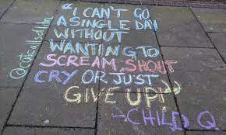
Case study Child Q - 2020
Black female 15 year old.
Teachers believed she smelt of cannabis and suspected she was carrying drugs.
They questioned her and completed a search of bags, blazer, scarf and shoes -nothing found. School requested further support from safer school's officer
Recommendation for police to be called on 101 and to ask for female officer.
Child was stripped searched by female officer in the school's medical room. Search involved exposure of intimate body parts whilst child was menstruating.
The search took place without an appropriate adult and her mother was not contacted.

Slide 48
Child Q inquiry - findings
School was fully compliant with practice standards responding to concerns about cannabis and the subsequent search of coat, bag and scarf and shoes.
The decision to strip search was not in the best interest of the child or their right to privacy.
School deferred to the authority of the police; they should have been more challenging seeking clarity of the actions.
All practitioners needed to consider the best interest of the child.
School had insufficient focus on safeguarding needs when responding to concerns about drugs.
Racism (deliberate or not) influenced the decision to strip search.

Slide 49
Case study – Jaden Moodie
14 year old Jaden from London was murdered in December 2029. He was knocked from his moped and stabbed to death.
SCR concluded “although Jaden’s murder could not have been foreseen or predicted, there are lessons for local and national agencies working with vulnerable young people and their families”:
1 Time spent away from school constitutes “a significant risk to children who are vulnerable to criminal exploitation”.
2 Jaden was criminally exploited, which led to his arrest for drug possession in Bournemouth in October 2018. The review makes clear this critical moment to help him was missed, largely due to the lack of effective communication.

Slide 50
Safeguarding practice
If adults working with children are unaware that they have unconscious bias or do not act to mitigate it, this may have a negative impact on their ability to identify and respond appropriately to child abuse (IICSA, 2020).
Unconscious bias might also lead practitioners to interpret behaviour differently depending on the ethnicity of the person displaying it. For instance, if a child from a Black, Asian and minoritised ethnic communities shows fear around a family member, this may be interpreted as a cultural expression of respect rather than an indicator of abuse (SCRA, 2017).
Practitioners might also have unconscious bias about who experiences different types of abuse… Without acknowledging and challenging these perceptions, practitioners might overlook the risk to children who do not fit the stereotype.
https://learning.nspcc.org.uk/safeguarding-child-protection/children-from-black-asian-minoritised-ethnic-communities
Notes:
Practitioners might also have unconscious bias about who experiences different types of abuse, for example by connecting specific abuse types with specific groups of people. Without acknowledging and challenging these perceptions, practitioners might overlook the risk to children who do not fit the stereotype. NSPCC
Leading from the top.
Explore of the context and environment practitioners are working within.
Working in an environment where racism or just talking about discrimination or even acknowledging it isn’t normalised, then of course there is going to be an impact on how safe and confident staff feel to have those conversations, and to challenge one another or our different partner agencies.
Farrer & Co 2022

Slide 51
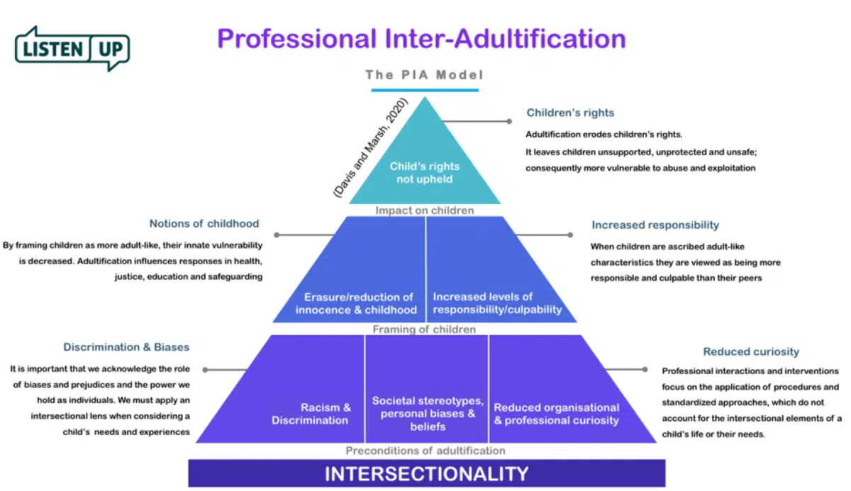

Slide 52
Professional curiosity
Consider the identity of the child – intersectionality
Identify conscious and unconscious bias
Be aware of language – avoid and challenge victim blaming
Understand gaps in your own knowledge
Gather support - get wider views
Use supervision for professional reflection and to challenge own thinking

Slide 53
Your next steps…
Want to find out more about adultification?
Listen Up website: https://listenupresearch.org/
Farrer and Co Q&A https://www.farrer.co.uk/news-and-insights/adultification-bias-of-black-children-qa-with-jahnine-davis/
“Be courageous and lean into your discomfort. It starts with your own acknowledgment of your biases”. Jahnine Davis

Slide 54
Questions

