Slide 1
Stream 6 - Investigations
Presenters
Louise Davies – Arthur Terry Learning Partnership
Stacey Anderson - Creative Education Trust
Nikki Cameron and Steph Morley - Ormiston Academies Trust
Session Number

Slide 2
Curiosity and Professional Challenge
Louise Davies
Trust Safeguarding Lead
The Arthur Terry Learning Partnership
Session 6.1

Slide 3
Notes:
Explain that it’s easy to not notice things we are not looking for. How can we relate this to safeguarding? Lot to think about as an DSL but we must not be blinkered to what may be happening.

Slide 4
We stop being curious because we stop asking questions not the other way around
We all come into the world curious.
“The greatest invention in the world is the mind of a child”
Thomas Edison
At 5 years old 98% of children have no problem thinking divergently. Not surprising as under 3s ask their parents on average 100 questions a day.
Sadly by the age of 25, only 2% can think outside the box.
By 10-11 years children have pretty much stopped asking questions

Slide 5
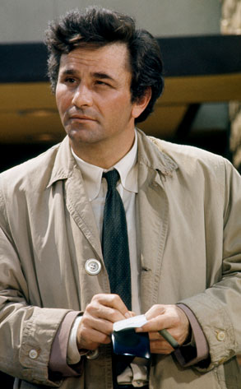
What is professional curiosity? Just a ‘buzz term?
It is the capacity and communication skill to explore and understand what is happening within a family rather than making assumptions or accepting things at face value. ​
It is a combination of looking, listening, asking direct questions, checking out and reflecting on information received.
It means:
testing out your professional hypothesis and not making assumptions
triangulating information from different sources to gain a better understanding of individuals and family functioning
getting an understanding of individuals’ and families history which in turn may inform the future
obtaining multiple sources of information and not accepting a single set of details you are given at face value
having an awareness of your own personal bias and how that affects how you see those you are working with

Slide 6
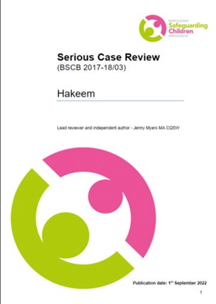
It’s acutely real…
“There was not enough professional curiosity as to what else was happening to Hakeen”
“It calls for authoritative professional practice, defined as an ability to demonstrate professional curiosity, respectful uncertainty and being able to challenge parents and other professionals”

Slide 7
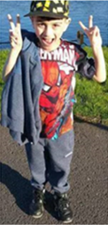
“I am 5% happy, 100% angry and 1000% scared.”
“I have not had any dinner, I sometimes have breakfast, sometimes lunch, but not during Saturdays and Sundays.”
“I don’t wash regularly as there is no money for gas and electric.”
“My mum sleeps all day, and no one takes me to school”
“I take care of myself whilst mum is asleep.”
Notes:
The full SCR for Hakeem Hussain is available here: 2022BirminghamHakeemCSPR.pdf (nspcc.org.uk)

Slide 8
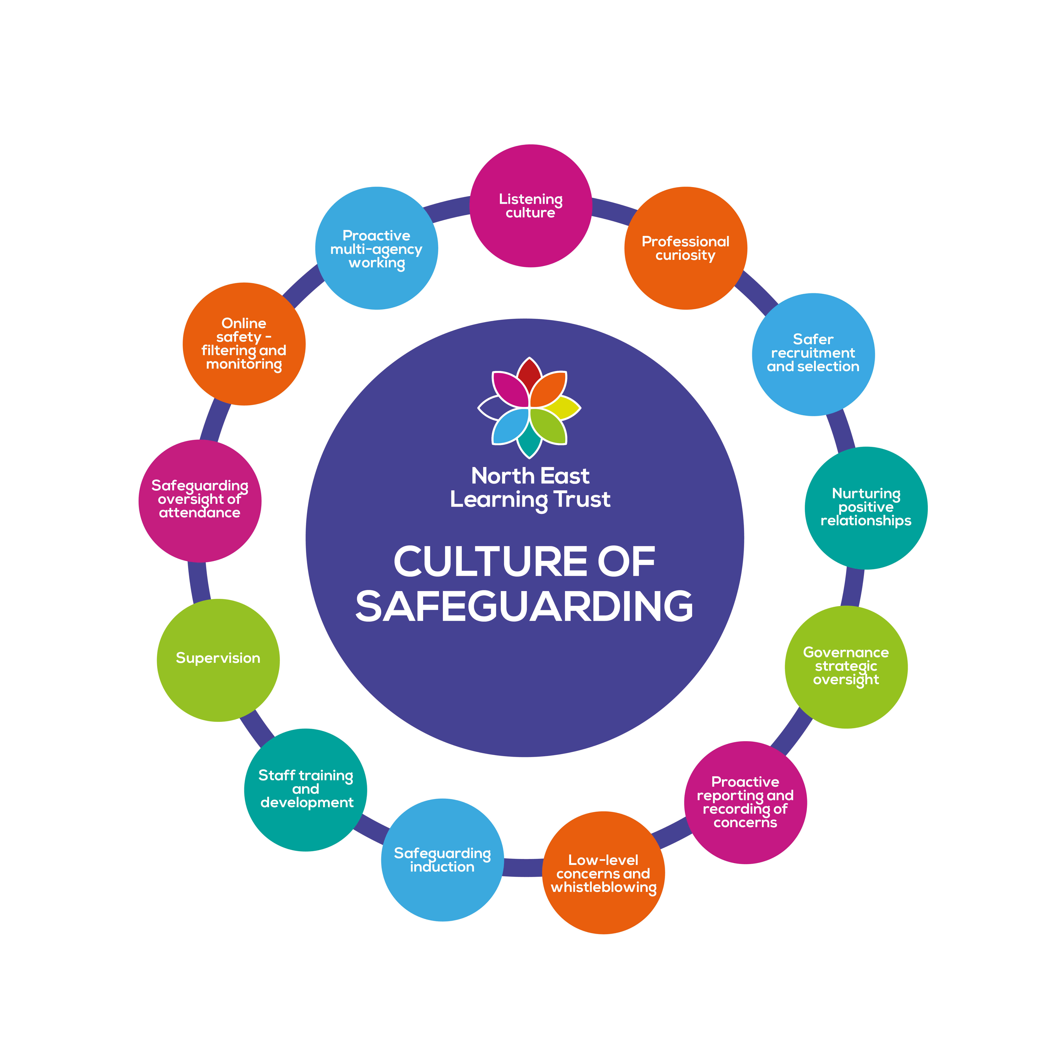
Why is curiosity and professional challenge important?
WTTSC 2023 - Nurturing professional curiosity is a fundamental aspect of working together to keep children safe.
KCSIE 2023 makes specific reference to it being an essential aspect of the school safeguarding offer
“ All staff should be aware that children may not feel ready or know how to tell someone that they are being abused, exploited, or neglected, and/or they may not recognise their experiences as harmful. For example, children may feel embarrassed, humiliated, or being threatened. This could be due to their vulnerability, disability and/or sexual orientation or language barriers. This should not prevent staff from having a professional curiosity and speaking to the DSL if they have concerns about a child. It is also important that staff determine how best to build trusted relationships with children and young people which facilitate communication.”
SPR av. 85% of SPR cite curiosity and professional challenge as an essential 'lesson learned' - this has been a constant for 5+years
Notes:
Expand specifics in delivery if time

Slide 9
Practicality of exercising (and evidencing) professional curiosity?
How are these following slides embedded in communication between staff and students in your setting?
Have all staff received training on professional curiosity not just the safeguarding/pastoral/well-being teams?
Do they form the basis of case clinics? Are they part of your supervision?
Do you quality assure this element of a strong culture of safeguarding as a DSL?
See handout

Slide 10
There are barriers to effective curiosity – Professional Dangerousness
Tony Morrison described child protection as "anxious work". It triggers issues and difficulties not just for the families concerned but for the professionals and organisations working with them. These issues can be a catalyst to situations where children are not put first, "due to a mix of personal and professional issues, and agency culture support problems" (Littlechild, 2013). Morrison coined the phrase Professional Dangerousness to describe “the process whereby professionals involved in Child Protection work can behave in a way which either colludes with or increases the dangerous dynamics of the abusing family.” (Morrison, 1990). (See handout for further details)
Disguised compliance – individuals give the appearance of co-operating with Social Services (any professional) to avoid raising suspicions, to allay professional concerns and ultimately to reduce professional involvement.
The rule of optimism - a well-known dynamic in which professionals can tend to rationalise away new or escalating risks despite clear evidence to the contrary – particular risk within ‘ Signs of Safety’ model.
Accumulating risk – failing to see the whole picture and cumulative risk/impact of series of worries . SCRs repeatedly demonstrate that professionals tend to respond to each situation or new risk discreetly.
Normalisation – desensitisation due to it being wide spread/common issue – because they are seen as ‘normal’ they cease to be questioned and are therefore not recognised as potential risks or assessed as such.
Professional deference – those working closely are better equipped to inform decisions but ‘higher’ more detached management perceive the risk differently despite being less informed. Particular issue when LAs are controlling data of cases.
‘Knowing but not knowing’ This is about having a sense that something is not right but not knowing exactly what. Problematic to articulate, evidence and take action.
Confirmation bias - when evidence is sought that supports or confirms our pre-held view, and ignores contrary information. It occurs when we filter out potentially useful facts and opinions that are not in line with pre-conceived ideas.
Confidence – particular issue with complex situations /families or with aggressive adults. Focus can be directed from intended focus – dominant individuals/family controlling the narrative
Uncertainty - Contested accounts, vague /retracted disclosures & deception are common in safeguarding practice. Practitioners can be presented with concerns which are hard to substantiate – often these are discounted as not evidenced.
Notes:
You will likely recognise several of these even if you weren’t aware of the specific terminology. These and the handout can be cited sensitively in your professional challenge - part of your 'what we're worried about' statement.

Slide 11
How our curiosity becomes effective professional challenge?
Know your LSCB and the escalation process
Know your LA management structure – forge links – join task & finish/working groups – an existing respectful professional relationshop helps challenge
Track – lozenge on CPOMS – how else do you evidence this being part of your culture
Read your LA Annual Children’s Service Reports and strategies – know your local priorities – cite them in your challenge
Ask that a formal dissent in recorded in CP Conferences – this should be minuted and IRO should escalate to Children’s Service
Don’t take it or make it personal
Put it in writing – following meetings, decision making etc (save some stock for easy of cut and paste!)
Read your local and national Safeguarding Practice Reviews – be aware of thematic reviews
Cite safeguarding practise reviews in your challenge
Notes:
How confident are you and the DSL and safeguarding team around challenge?

Slide 12
Professional Curiosity – in brief
We have the capacity to look beyond face value. We can think the unthinkable. We are Curious professionals who practise quality interactions they engage students through conversation, observation, asking questions then reflection.
We understand the reasons why it is important to be professionally curious: ensuring safeguarding is proactive, adherence to KSCIE and learning from Safeguarding Practise Reviews
AWARE principle AppearanceWords Activity RelationshipsEnvironment
We are aware of the barriers: disguised compliance, normalisation, rule of optimism, professional deference, confirmation bias, ‘knowing but not knowing’, accumulating risk, uncertainty and confidence. .
We know what we can do: remain diligent, access quality training, develop meaningful connections with students, have quality conversations, embody a reflective approach, develop skills for difficult conversations, remain respectfully curious record and report all concerns
Notes:
One for the office wall?

Slide 13
He wasn’t far wrong… (with a couple of exceptions!)

Slide 14
So...
"...if you tell me that curiosity killed the cat, I'd say only that the cat died nobly" Arnold Edinborough

Slide 15
Questions

Slide 16
Investigation Skills: Top Tips for Undertaking an Investigation
Stacey Anderson
Trust Safeguarding Lead
South Pennine Academies / Creative Education Trust
6.2

Slide 17
Commencing an investigation
Investigations may be triggered by a relatively minor transgression of the code of conduct or a more serious matter, whatever the scenario, investigations should be handled with care.
Where mistakes are made in an investigation an escalation of error can occur whereby the mistakes made earlier come back and cause issues in later processes and may make the process unfair and subject to challenge.
Getting an investigation right at the start is important to prevent this.

Slide 18
Process
In nearly all cases an investigation will involve:
An allegation or complaint is received
A decision is made to investigate the issue
Evidence gathering
Analysis of the evidence
Report or recommendations

Slide 19
Assess the information
The starting point is to carefully assess the information that has come in.
What has happened (if anything)
Who is involved (known or unknown parties)
Be clear about the nature of the allegation – is it potentially a criminal matter or a safeguarding case? Will there be third party involvement?
What breaches of policy or misconduct have been identified and how was it identified or reported?

Slide 20
Tip 1 : Read Your Policy
Policies will vary between schools so ensure that you have read and understood your policy before starting an investigation to prevent issues arising later down the road.
Consider relevant guidance such as Equality and Human Rights, Keeping Children Safe in Education along with local safeguarding procedures where applicable.
The policy should be compliant with ACAS Code of Practice for Disciplinary and Grievance Procedures – so it is important that you are familiar with the code as well.

Slide 21
Decide on an Investigator
Think about the complexity of the investigation and consider the skill and experience of the potential investigators.
Consider the time and commitment needed to get the investigation done – investigations inevitably take longer than generally anticipated.

Slide 22
Tip 2 : Be independent and impartial
As Investigating Officer you should be independent with no prior involvement in the grievance/complaint
Consideration should be given to who is best to undertake the investigation along with setting aside staff for other key roles:
1. An investigator to look at the facts of the case (IO)
2. Hearing Officer / Panel – the decision-maker(s)
Appeal Manager
The IO must approach the investigation with an open mind.

Slide 23
Investigation Plan
Define the parameters of the investigation, the resources needed, the suggested methodology and timeframe.
Identify any risk areas as well as support needs for those involved in the investigation.
Keep the plan under review and update it when necessary.

Slide 24
Tip 3 : Know the scope of the investigation
What are you actually investigating?
What are the clear concerns you need to look into?
Agree the remit of the investigation

Slide 25
Tip 4 : Be prepared
Create a plan – think about the scope of the investigation, what documents you might need to review and who you may need to speak to. Update the plan as you go along.
Prepare questions in advance but be flexible to adjust during meetings as appropriate/ Give yourself time to pause and think about responses in case you need more information before moving on.
Ensure you speak to people in the right order
Who raised the grievance first to ensure you fully understand their concerns and expectations
Person under investigation last so they can comment on the facts that you have gathered

Slide 26
Record Keeping
Investigators should not simply record actions taken but also thought processes and actions that have been considered but not taken – with reasons for this.
This will help evaluate the decision making process and can be helpful later as part of the paper trail into how the matter was dealt with.

Slide 27
Record Keeping
Applying this to safeguarding incidents in schools
FACTS based record keeping

Slide 28
Tip 5 : Be detailed
Gather all the facts and speak to all relevant witnesses for balanced evidence
5 W’s: Who, What, Why, Where, When
Don’t be afraid to go back to a witness to ask for further information
In the investigations meetings ask the employee for witnesses and documents to support their evidence
A detailed investigation is important because:
In the event of an Unfair Dismissal Claim a Tribunal will consider whether an investigations was reasonable
the Investigating Officer will be a key witness

Slide 29
Tip 6 : Manage expectations
Employees should be given a reasonable time frame when to expect to hear the outcome – keeping them waiting weeks or months without an update may add to frustration and may lead to further grievances
Investigations are stressful and managing expectations helps support the mental health and well being of the employee
From the beginning the employee should be told:
Why you are carrying out an investigation
Who will be carrying it out
What you are going to do
You will need to talk to witnesses
How long the investigation will take
Next steps

Slide 30
Tricky Issues
Confidentiality
Reluctant witnesses / anonymity
Sickness absence
Grievances about the process

Slide 31
1. Confidentiality
School communities tend to be quite close-knit so confidentiality can be a big issue.
Matters under investigation should remain confidential or this may compromise a fair investigation. This means that the identity and facts of the allegation and investigation will be kept to a “need to know basis” and do not compromise a duty to report.
A breach in confidentiality could in itself become a disciplinary matter.
Confidentiality should be emphasised throughout the process, especially during the investigation's meetings.
It is helpful to be clear why confidentiality must be respected so it is not construed as an attempt to hush things up – gossip, rumour and speculation needs to be actively managed although this can be difficult.

Slide 32
2. Reluctant witnesses / anonymity
It is important to find out why witnesses are reluctant to provide a statement in order to attempt to resolve the issue – walking them through the investigation process, explaining how the evidence will be used, reminding them about confidentiality and reassuring them that they have the school’s support and protection may help.
They can also be reminded of the obligation of good faith owed to an employer.
ACAS guidance states that anonymous witness statements should only be taken in exceptional circumstances.

Slide 33
3. Sickness absence
It is common for employees to be signed off sick, often with anxiety or stress during a disciplinary process. You can consider options such as holding meetings offsite or online or possibly obtaining written representations or statements instead.
Ensure relevant referrals are made for support during this process.
Ultimately you may have to consider proceeding with the investigations in the employee’s absence.

Slide 34
4. Grievances about the process
If an employee raises a grievance during the disciplinary process ACAS Code states the process may be temporarily suspended to deal with the grievance.
However, if the cases are related it may be better to deal with both issues concurrently.
If no action is taken to investigate the grievance it will be seen as a breach of the ACAS Code and could impact on the perceived impartiality of the investigation.
Unless the grievance throws doubt on whether the disciplinary process can be conducted fairly the substance of the grievance can be discussed in the context of the hearing and once the process is complete any outstanding grievances can be dealt with.

Slide 35
Managing the end of an investigation
The Report
You should go through each concern and:
Confirm the evidence considered
Summarise
Make a recommendation on the next steps
The evidence considered should form appendices to the report (e.g. notes from the investigation meetings, digital or written evidence)
The report should summarise the facts in the case – not opinions.

Slide 36
Recommendations
The Investigating Officers role is to make recommendations not judgements.
Grievance – the main recommendation is whether or not to uphold the concern, but you can also make recommendations on:
How to resolve concerns
Training or coaching for those involved
Counselling
Mediation
Changes to policy or procedure
Disciplinary process
Disciplinary – if there is a case to answer to, recommend to proceed with a disciplinary hearing. If not, you may recommend informal management guidance is given instead.
Be prepared to present your report and answer any questions at any resulting hearing.

Slide 37
Questions

Slide 38
Court Ready Records
Nikki Cameron and Steph Morley
Head and Deputy Head of Safeguarding
Ormiston Academies Trust
6.3

Slide 39
Ormiston Academies Trust
Ormiston Trust – founded in 1969 by Peter Murray in memory of his sister Fiona Ormiston Murray
Nationwide. Ormiston Academies- from Grimsby to Cowes
42 Academies - primary, secondary, special and AP

Slide 40
6.3 Court Ready Records
Learning from serious case reviews has identified examples of poor practice which led to children not receiving the right help at the right time to address safeguarding issues and prevent issues escalating.
Failing to act on and refer the early signs of abuse and neglect
Poor record keeping
Failing to listen to the views of the child
Failing to re-assess concerns when situations do not improve
Not sharing information with the right people within and between agencies
Sharing information too slowly
Lack of challenge to those who appear not to be taking action

Slide 41
6.3 Court Ready Records
Effective recording helps…
identify concerns at an early stage
build a picture of a child’s experience
identify patterns
evidence actions taken and their impact on the child
support the need for escalation and professional challenge
provide understanding of decision rationale
evidence safeguarding culture

Slide 42
Criticisms of recording
“Pupils’ safeguarding records lack detail and some leaders’ actions are not recorded.”
“Records lack sufficient detail. They do not include the dates on which things take place.”
“Leaders have not kept accurate records of the concerns raised about pupils’ welfare…Leaders have not analysed records carefully to spot signs of abuse.”
“First-hand accounts are not recorded. Although concerns are dealt with satisfactorily, there is a lack of emphasis on the importance of first-hand reporting.”

Slide 43
Records - what can be requested?
Apart from safeguarding recording systems, what systems are used in your school for recording information on a child?
Class Charts
DC Pro
iAm compliant
Hand written notes
SIMS
School counsellor’s notes
Attendance

Slide 44
6.3 Court Ready Records
Purpose
Audience
Why is it being recorded?
What do you expect to happen?
Who is the intended audience?
Who else could read it?
How should it be recorded? fact/opinion/tone/etc
Language

Slide 45
Purpose
To alert
For action
Accountability
Transparency
Improvement
To inform

Slide 46
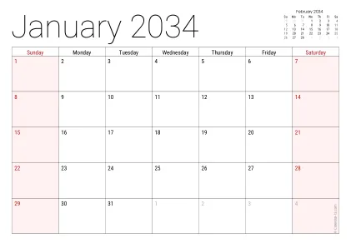
Audiences
DSL
Key academy/trust staff
Courts/legal proceedings/child safeguarding practice reviews
Parents/carers
The child
Statutory Safeguarding Partners

Slide 47
Language
Professional
Own words- primary evidence/ contemporaneous notes
Non -judgmental
Clear
Complete
Factual

Slide 48
Language- a skill to be developed
One of the most important skills for documenting and reporting safeguarding concerns is to use clear, precise, concise, factual, non -judgmental language
“The front room was in a terrible state”
The front room contained 14 bags of rubbish and I saw 20 empty fast -food packages. I also saw what looked like mice droppings in the corner of the room next to the kitchen door
“displayed inappropriate sexual behaviour”
He put both his hands on her breasts.

Slide 49
Language – remaining child centred
Through our language, are we unconsciously reinforcing perceptions of children as making active choices in their exploitation?
Are we using victim blaming language?
Children’s Soc 2022 Child_Exploitation Appropriate_Language_Guide 2022.pdf (childrenssociety.org.uk)

Slide 50
Language – ‘Disclosure’ vs ‘Allegation’
Why should we avoid using the word
‘disclosure’
in report/account writing?

Slide 51
Decision rationale
Include:
Why the decision was made
Who was included in the decision making?
Actions taken

Slide 52
Quality Assurance – getting better
Practice
Dip sample

Slide 53
Questions
Mat Logo

