Slide 1
Stream 5 – DSL role
Presenters
Louise Veeran – Dioceses of Norwich Education Services company
Diane Parkinson – Ethos Academy Trust
Jacqui Ferris – Academy Transformation Trust
Erin Docherty – Oasis Community Learning
Becci Owen – Oasis Community Learning
Session Number

Slide 2
Developing the DSL as a strategic leader
Louise Veeren
Diocese of Norwich Education Services
Diane Parkinson
Ethos Academy Trust
Session 5.1

Slide 3
Developing the DSL as a strategic leader.
Key areas to consider in this session:
Supporting DSL’s to be more strategic whilst recognising the challenges
DSL’s can become a ‘single point of failure’ – how do we avoid this?
Align safeguarding to other areas of responsibility with senior leaders

Slide 4
Supporting DSL’s to become more strategic whilst recognising the challenges
DSL’s often have to wear many ‘hats’ and will have other responsibilities alongside safeguarding.
Ensure that safeguarding is embedded within the school development plan and through all areas of school.
Do other leaders all take responsibility for safeguarding within their roles?
Is this a regular agenda item on SLT meetings?
Consider future proofing safeguarding provision and ensuring there is succession planning to ensure continuity
TASK-Discuss what the major challenges are to you working more strategically.

Slide 5
Developing the DSL as a strategic leader.
The lead DSL is not solely responsible….. They are the person that holds it together.
Consider strategies to support DSL’s:
What aspect of the role can be shared with DDSL’s or other colleagues?
Are we good at ‘letting go’?
Are we mindful of our own wellbeing within the role or can we be insular? TASK: Can some aspects of the role be delegated to other staff? What would this look like and what are the barriers?

Slide 6
Are there aspects of the role that could be shared with other senior leaders or colleagues?
Think about the curriculum and how this supports safeguarding
Avoid holding all the information so that absence can cause operational and strategic gaps
Are there signposting opportunities both locally and nationally that could support you or your team?
Is there appropriate training and support in place for DDSL’s or other colleagues? Is safeguarding a shared priority?
Is there an opportunity for the analysis of data to be delegated to a colleague who can then provide a focused response.
TASK: Consider an individual scenario and how you could have delegated or utilised other colleagues more efficiently.

Slide 7
Your to do list in becoming more strategic
Summarize what changes need to take place in your setting to be able to fully embed and develop the DSL as a strategic leader
Ensure that this captures both operational and strategic planning and is sustainable
Take a wider view of safeguarding to include all safeguarding and DSL teams.
Consider staff recruitment and retention and how safeguarding teams will be developed
Consider how will you ensure that the steps you do take are in line with the Trust/settings long term vision?
If the measure of success is the succession plan….. i.e when you leave it all continues without disruption. How can this be achieved?

Slide 9
Supervision and Reflective Practice
Jacqui Ferris
Deputy Director of Safeguarding
Academy Transformation Trust
Session 5.2

Slide 10
“Vulnerability is the birthplace of innovation, creativity and change.” ― Brene Brown

Slide 11
Education: learning from case reviews (nspcc.org.uk) Feb 2023
Schools see children regularly over a long period of time. They are well positioned to pick up on ongoing concerns, or changes in circumstances.
Concerns should be seen in context, rather than responding to each incident in isolation. Accurate records should be kept, enabling professionals to identify patterns in concerns.
Information about all siblings attending the same school should be considered where there are concerns around the attendance, behaviour, wellbeing or safety of any one child.
Safeguarding supervision can provide teachers with a space to reflect on concerns and reach decisions.
Sign up for case reviews https://learning.nspcc.org.uk/newsletter/case-reviews-update

Slide 12
How many of you ……….
Receive regular formal supervision?
Receive some form of regular informal supervision?
Have had training to provide supervision for colleagues?
Provide formal supervision for colleagues?

Slide 13
What is Reflective Practice?
Experience: What happened? Observations
Reflection; What was it like?
Feelings
Analysis: understanding what? why?
Thinking
Taking Action: Trying out, planning, adapting.
Doing
Reflective practice was something which developed in disciplines such as teaching, medicine and social work as a way to learn from real life experiences.
Based on David Kolb's reflective learning cycle 1984

Slide 14
What is Supervision?
Supervision is a process of professional learning and development that enables individuals to reflect on and develop their knowledge, skills, and competence, through agreed and regular support with another professional.

Slide 15
The four functions of supervision
Managerial function
Competent accountable performance
Developmental function
CPD
Supportive function
Personal support
Mediation function
Engaging your colleague with the school
TED Questions
Tell me
Explain to me
Describe to me

Slide 16
Consciously prompting reflective thinking
Experience
What happened?
What struck you?
What else is happening for this child?
What’s hard to observe?
TED Questions
Tell me
Explain to me
Describe to me

Slide 17
Consciously prompting reflective thinking
Reflection (feelings)
What feelings did you bring to the session?
What’s your gut feeling about the situation?
What assumptions are you making?
TED Questions
Tell me
Explain to me
Describe to me

Slide 18
Consciously prompting reflective thinking
Analysis (thinking)
What are you concerned about?
What training or values can you apply?
What are the risks, needs and strengths of the situation?
TED Questions
Tell me
Explain to me
Describe to me

Slide 19
Consciously prompting reflective thinking
Plan (doing)
Following our conversation what is your overall summary?
Do you need any more information before proceeding?
What will you do next?
TED Questions
Tell me
Explain to me
Describe to me

Slide 20
Consciously prompting reflective thinking
And what else……?

Slide 21
Scenario for reflection with the person next to you
A new member of your team notices a father shouting at his 8-year-old son when he comes to collect him. He is shouting in another language and your colleague isn't sure what is being said. Your colleague has heard that other parents are worried about the child and saying the father often appears to be quite angry. Your colleague is raising this with you but doesn't want to report it in case they have misunderstood due to the language barrier. They wonder if they should wait and see if the boy says anything to them about his father’s behaviour.
What questions would you ask?
Which of the 4 functions of supervision would this cover?
Learning cycle
Experience
Reflection (feeling)
Analysis (thinking)
Plan (doing)
4 Functions
Managerial
Developmental
Supportive
Mediation

Slide 22
ATT Supervision Model
Peer Based Supervision
Supervision sessions
Community group case discussion (anonymised)
Trust Level Supervision
Stuck/ Challenging Case Discussion
Supervision (as and when required)
Supervision records reviewed for key themes
Academy Based Supervision
DSL supervises DDSL/ ADSL
Team case load discussion
TAC meetings

Slide 23
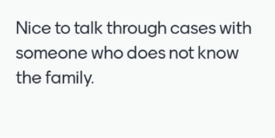
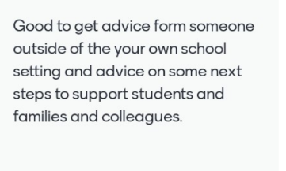
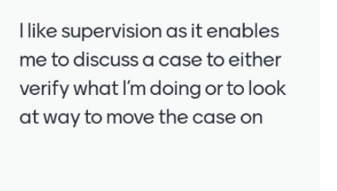
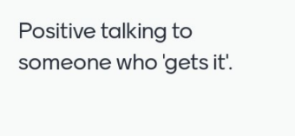
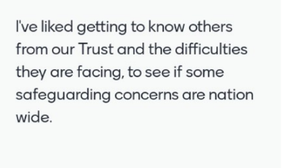
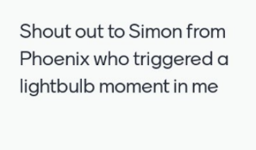

Slide 24
What can I take away?
'Coffee table' supervision
Conscious reflection
Key questions

Slide 25
Safeguarding Culture
Lessons Learned
Team Building
Outcomes for Children
Professional Curiosity versus Professional Dangerousness
Challenge

Slide 26
Questions

Slide 27
Supporting staff through a mental health crisis
Erin Docherty/Becci Owen
Safeguarding and Mental Health Team
Oasis Community Learning
Session 5.3

Slide 28
In a survey of 3,082 education professionals:
75% of all staff are stressed (84% of senior leaders, 72% of school teachers)
47% of all staff always go into work when unwell (61% of senior leaders, 45% of school teachers)
78% of all staff experienced mental health symptoms due to their work (87% senior leaders, 76% school teachers)
Notes:
The findings, part of the 2022 Teacher Wellbeing Index, conducted annually by the charity Education Support in conjunction with YouGov showed that overall, stress levels have increased when compared to 2021. Staff working in education also continue to experience higher levels of depression and anxiety than those reported in the general population.

Slide 29
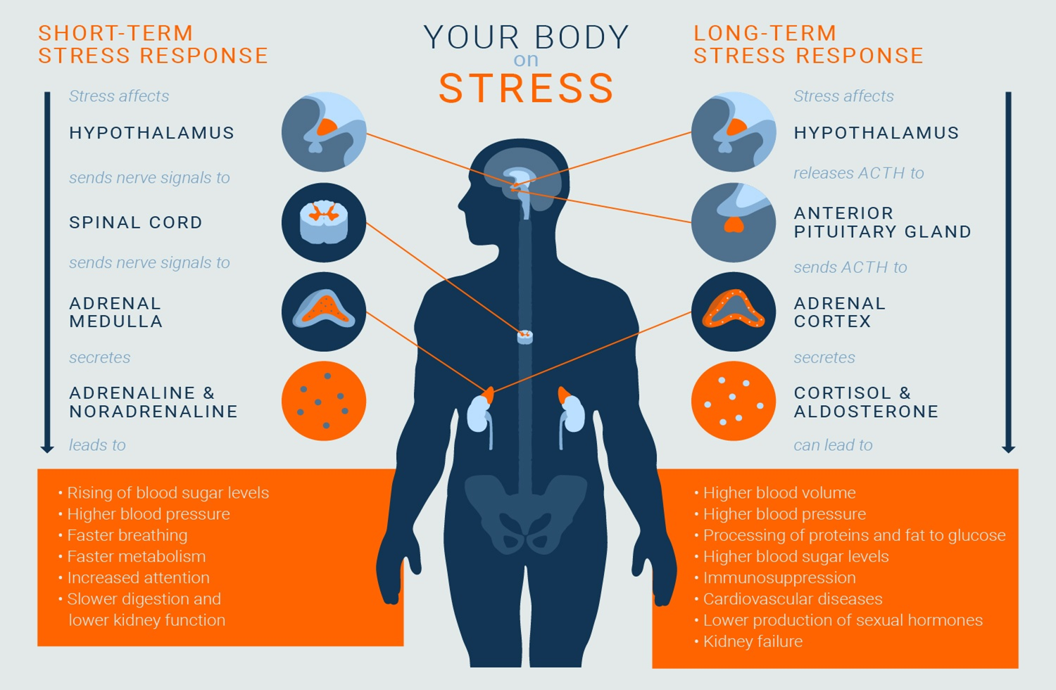
Notes:
Stress is a natural physical and mental reaction to life experiences. Everyone expresses stress from time to time. Anything from everyday responsibilities like work and family to serious life events such as a new diagnosis, war, or the death of a loved one can trigger stress. For immediate, short-term situations, stress can be beneficial to your health. It can help you cope with potentially serious situations. Your body responds to stress by releasing hormones that increase your heart and breathing rates and ready your muscles to respond.
Yet if your stress response doesn’t stop firing, and these stress levels stay elevated far longer than is necessary for survival, it can take a toll on your health. Chronic stress can cause a variety of symptoms and affect your overall well-being. Symptoms of chronic stress include:
irritability
anxiety
depression
headaches
insomnia

Slide 31
Signs of Burnout
Stress
Anxiety
Irritability
Depression
Frustration
Exhaustion (due to insomnia or sleep disturbances)

Slide 32
Signs of burnout
Difficulty concentrating and making decisions
Poor work quality
Decreased motivation and job satisfaction
More cynical and detached
Increased conflict
Physical symptoms like headaches, stomach aches or back pain
Substance abuse

Slide 34
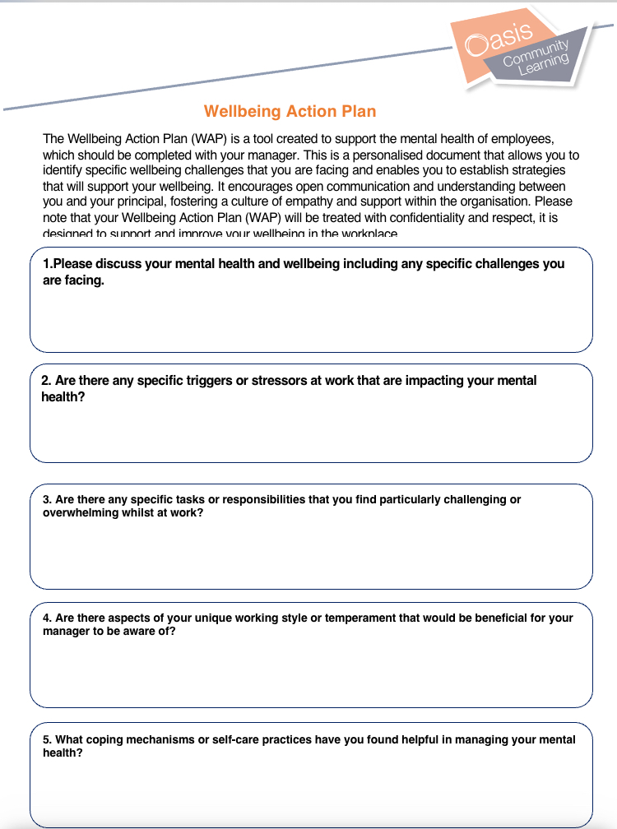

Slide 35
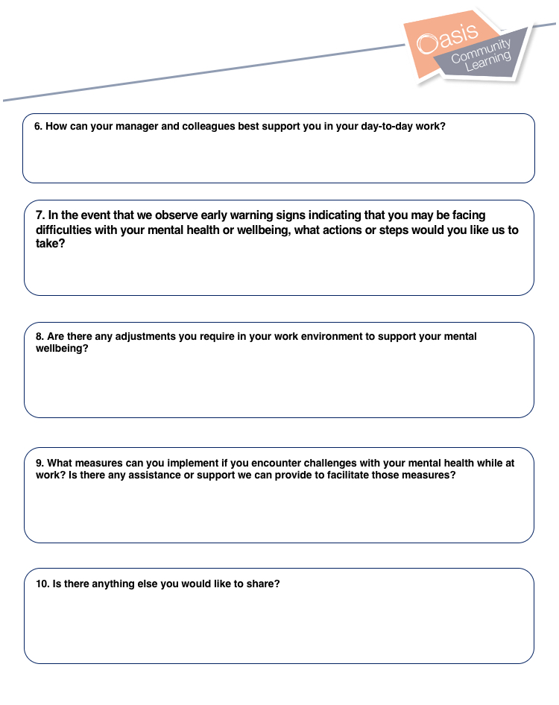

Slide 36
Having a well-being conversation
Think about the timing
Consider the environment
Agree boundaries around confidentiality
Use WINE (Wondering, Imagining, Noticing, Empathy)
Take notes
Summarise
Be clear on agreed actions

Slide 37
How is your sleep? Are you sleeping to much? To little? Waking up during the night?
How is your appetite?
How has your mood been recently? Have you felt lower than normal?
Is there anything you are worrying about right now at work/at home or in your community?
Who is supporting you – in school/at home
Have you felt like this before?
What helps you when you have felt like this before OR what do you think might help?
Is there anything I can do to support you whilst you feel like this?

Slide 38
Risk Questions
You would ask Risk Questions in the following circumstances:
Where the staff member has disclosed to you or others that they have had suicidal thoughts
Where there has been a history of suicidal thoughts or suicide attempts
Where there is a marked change in behaviour or presentation that has caused you significant concern

Slide 39
Asking the question
Things sound really difficult at the moment, have you had any thoughts of not wanting to be here anymore?
It sounds as if things are really tough, have you ever had or are you having thoughts now of ending your life?
Often when people go through difficult times, they can have thoughts of suicide, have you experienced this?
Have you had any thoughts of harming yourself or anyone else?

Slide 40
If the answer is yes
Thank you for telling me, I know it’s really hard but you need to know you are not alone, I will help you get support with these thoughts.
Have you thought about where, when or how you may act on these thoughts?
Is there anything stopping you acting on these thoughts?
Suicidal thoughts are really common when we feel very low, I want you to get help so you no longer feel this way

Slide 41
If the answer is no
Thank you for talking to me, I know it’s not an easy subject to talk about.
Who would you talk to if you did have these thoughts?
How might you keep yourself safe if these thoughts did occur?
Building a safety plan

Slide 42
Building a safety plan
Wellbeing Care Plan including local number for NHS Crisis Team, SHOUT and NHS111.
Encourage GP appointment
Occupational Health Referral
1:1 weekly until mental health improves
Consider amended duties/hours if appropriate to support recovery

Slide 43
Safety plan example

Slide 44
Where there is immediate risk
Ensure the staff member is reviewed by a medical professional. This can be GP, Paramedic or at A&E department. Call NHS111 or 999 if medical risk
If immediate risk, do not leave unaccompanied
Arrange a review meeting and ensure you stick to it

Slide 45
Questions

