Slide 1
Stream 3 – Pastoral Support
Presenters
Judith Wesley – David Ross Education Trust
Sue Bailey – Arthur Terry Learning Trust
Dr Jon Needham – Oasis Community Learning
Session Number

Slide 2
Developing a Pastoral Offer
Judith Wesley
Deputy Head of Safeguarding
David Ross Education Trust
3.1

Slide 3
Session Oversight
What is a Pastoral offer?
Different Trust ethos’
Know your why
Next steps
Not a quick fix
Notes:
Pastoral Offer - Is intervention - is additional support for the whole child and is about removing barriers to learning. Is a whole school approach a strong pastoral offer supports the development of a culture of safeguarding. Is everything additional to teaching and learning. (SEN crosses over - universal SEN vs SEN intervention offer) A pastoral offer is highly collaborative (touch on early help cross over?)
A strong pastoral offer is trauma informed???
A pastoral offer is intentional and evidence based
It isn’t - behaviour management it isn’t a quick fix

Slide 4
Wellspring Academy Trust
We believe that every child has the right to an engaging, exciting education. We believe in inclusive, supportive and empathetic learning environments for children and young people. We champion inclusive education, stronger communities and improved life chances.
We believe that education is the vehicle for improved outcomes for all. Improved outcomes for all aid the cause of social justice through equity. This is why we are so passionate about what we do.
We champion inclusive education, stronger communities and improving life chances. We are passionate about our social purpose: to make a difference.
When you join Wellspring Academy Trust you are committing to never permanently exclude a child, as we know that this only further negatively impacts their life. To date we are proud to say that our 31 schools have managed to achieve this through continuous positive regard.
This is achieved through a strong pastoral offer not only within our academies but centrally at Trust level. We have a team called Positive Regard who support both our academies internally and share their knowledge externally to support young people to remain in school and engaged.

Slide 5
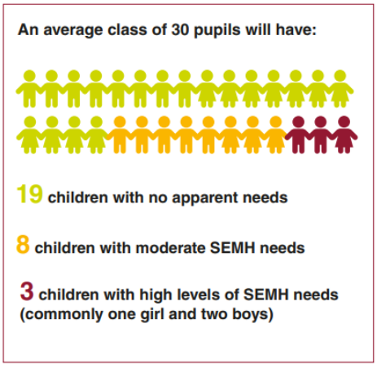
Know your why
Whole school approach
Pastoral impact will improve classroom learning
Not a quick-burst intervention to respond to behavioural or mental health conditions
Notes:
Nurture Programme 40 percentage point increase in key stage 2 Sats results for 10- and 11-year-olds (Oasis figures - Home grown programme)
but instead a longer-term programme, enabling children to rebuild trust, often damaged where attachments have been impaired
Is the visual from THRIVE? (Need Reference)

Slide 6
Next Steps
Gain feedback into the current needs, audit staff skills
Use data to assess the current climate and review the capacity within the setting
Decide what needs to be stopped, started and kept
Map policies and practices against outcomes and clearly outline roles and responsibilities
Include within your school development plan, CPD training and PDR targets
Ensure effective logging and recording procedures and review the impact
Communicate progress regularly
Notes:
Engaging the whole school community (staff, students and parents) is a key strategy to promote pastoral care in schools. Clemett and Pearce (1989) state that pastoral care is effective ‘when everyone in the school community knows, and feels secure in the knowledge that as valued members of that community, they can participate in giving and receiving encouragement, guidance and support’. Policies and programmes need to provide opportunities for staff, students and parents to be involved in making decisions, being heard and making a contribution to the community (Bernard, 1996).
A review of staff wellbeing will enable the assessment of the appropriateness and effectiveness of current systems, structures and services in the school that provide support in this area. Staff wellbeing can be enhanced through professional learning, celebrating staff strengths and achievements, policies to prevent and reduce staff stress, encouragement to collaborate with other staff, and access to professional advice (Cefai & Cavioni, 2014), (Cross & Lester, 2014), (Howieson & Semple, 2000). If staff wellbeing is cared for, then staff are more able to care for student wellbeing.
According to Cross, Lester and Barnes (2014), students present a socially relevant and accurate depiction of the quality of pastoral care provided in their school, hence their involvement in the review process is essential to guide school improvement. The review could assess student wellbeing using the four critical components of pastoral care: promotion of health and wellbeing; resilience; academic care; and social capital within the school community (Nadge, 2005). A variety of standardised reliable and valid measures can be used by schools to conduct this assessment.
Present the purpose, process, major findings and recommendations from a review to the staff and other members of the school community. To ensure ongoing engagement, support for and sustainability of pastoral care within the whole-school community, community members need to be updated regularly on the pastoral care activities and processes being implemented.
Schools have access to many different sources of data: academic, behavioural and attendance as well as student, parent and staff satisfaction surveys. These data can be used to measure the predictors of or the effectiveness of current pastoral care practices. Quantitative and qualitative data can be collected from all levels in the school - the whole-school level (senior executive team), from house or year groups, as well as tutors, students and parents and carers.
Pastoral care policies and practices can be mapped against the schools’ strategic plan and key pastoral care outcomes in order to identify existing overlaps and gaps. This stage also assesses the appropriateness and effectiveness of current systems, practices, policies and services, and the extent to which these achieve the identified wellbeing outcomes.
Teachers and other school staff need to clarify their understanding of their pastoral care role, and how their own actions, and their relationships with students, can enhance or harm the wellbeing of students (Best, 2002). This ‘academic care’ is influenced by: personal qualities of teachers and their relationships with students; the curriculum and its ability to promote meaningful participation and positive learning experiences; the school’s organisational structure and its ability to offer safety, support, trust, guidance and challenge; and links with the broader community.
Determination by staff of what is currently working well, what’s not working well, what’s missing and what’s promising in the school is essential, especially given the limited resources for pastoral care. This decision making may consider policies and practices related to the five key pastoral care school-level tasks: proactive, preventative pastoral care; developmental pastoral teaching and learning; the supportive/collaborative environment; reactive casework; and the management and administration of pastoral care (Department of Education, 2001).
Careful delineation of the roles and responsibilities of all members of the school community to promote a safe and supportive environment needs to be explicit, clearly understood by all and disseminated widely and often. This understanding reduces the pastoral care burden often experienced by pastoral leaders within the school, and encourages students, staff and families to recognise how much they can contribute to a positive, safe and supportive school culture.
Sufficient staff capacity and resources are needed to successfully align and integrate the outcomes of a pastoral care review into the school’s vision and strategic plan. A pastoral care ‘master plan’ can be used to guide and monitor the ongoing implementation of recommendations to the school community.

Slide 7
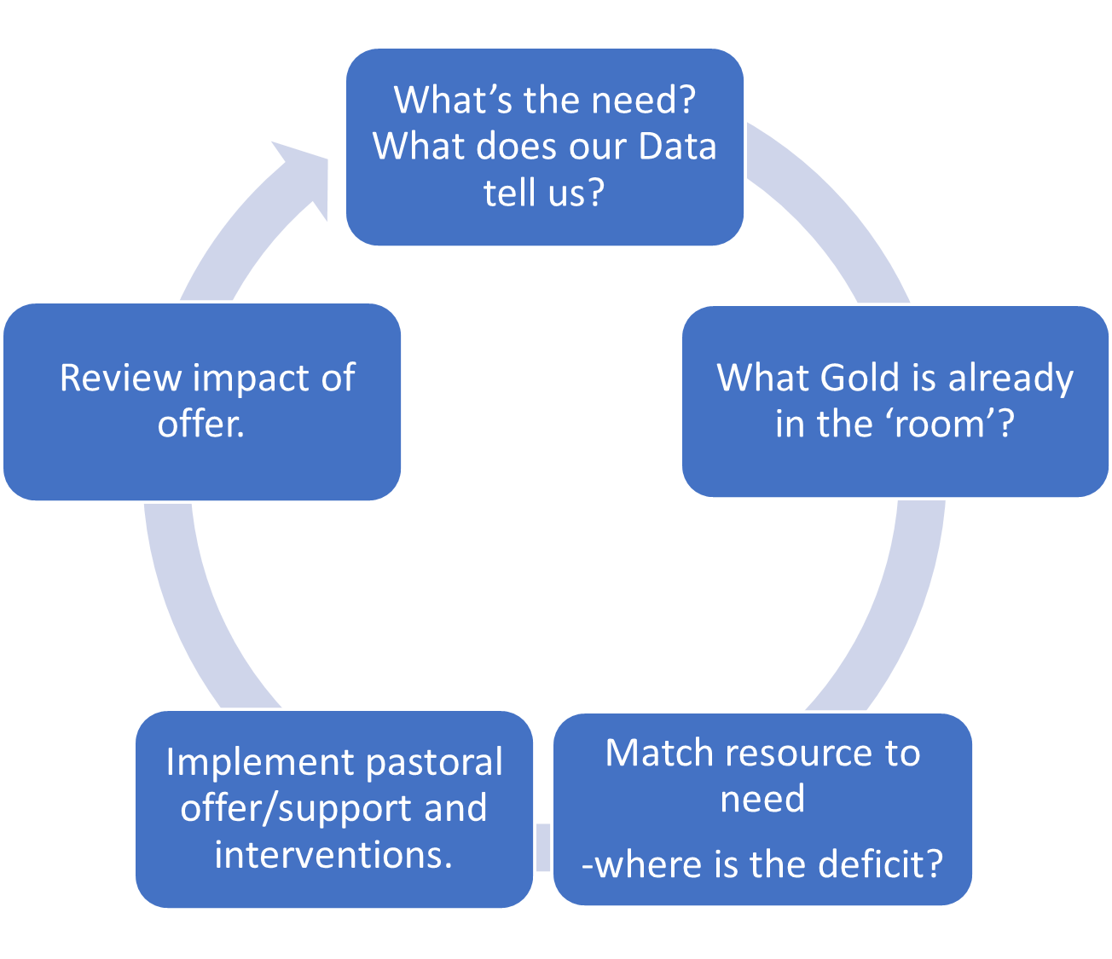
Next Steps
Notes:
Engaging the whole school community (staff, students and parents) is a key strategy to promote pastoral care in schools. Clemett and Pearce (1989) state that pastoral care is effective ‘when everyone in the school community knows, and feels secure in the knowledge that as valued members of that community, they can participate in giving and receiving encouragement, guidance and support’. Policies and programmes need to provide opportunities for staff, students and parents to be involved in making decisions, being heard and making a contribution to the community (Bernard, 1996).
A review of staff wellbeing will enable the assessment of the appropriateness and effectiveness of current systems, structures and services in the school that provide support in this area. Staff wellbeing can be enhanced through professional learning, celebrating staff strengths and achievements, policies to prevent and reduce staff stress, encouragement to collaborate with other staff, and access to professional advice (Cefai & Cavioni, 2014), (Cross & Lester, 2014), (Howieson & Semple, 2000). If staff wellbeing is cared for, then staff are more able to care for student wellbeing.
According to Cross, Lester and Barnes (2014), students present a socially relevant and accurate depiction of the quality of pastoral care provided in their school, hence their involvement in the review process is essential to guide school improvement. The review could assess student wellbeing using the four critical components of pastoral care: promotion of health and wellbeing; resilience; academic care; and social capital within the school community (Nadge, 2005). A variety of standardised reliable and valid measures can be used by schools to conduct this assessment.
Present the purpose, process, major findings and recommendations from a review to the staff and other members of the school community. To ensure ongoing engagement, support for and sustainability of pastoral care within the whole-school community, community members need to be updated regularly on the pastoral care activities and processes being implemented.
Schools have access to many different sources of data: academic, behavioural and attendance as well as student, parent and staff satisfaction surveys. These data can be used to measure the predictors of or the effectiveness of current pastoral care practices. Quantitative and qualitative data can be collected from all levels in the school - the whole-school level (senior executive team), from house or year groups, as well as tutors, students and parents and carers.
Pastoral care policies and practices can be mapped against the schools’ strategic plan and key pastoral care outcomes in order to identify existing overlaps and gaps. This stage also assesses the appropriateness and effectiveness of current systems, practices, policies and services, and the extent to which these achieve the identified wellbeing outcomes.
Teachers and other school staff need to clarify their understanding of their pastoral care role, and how their own actions, and their relationships with students, can enhance or harm the wellbeing of students (Best, 2002). This ‘academic care’ is influenced by: personal qualities of teachers and their relationships with students; the curriculum and its ability to promote meaningful participation and positive learning experiences; the school’s organisational structure and its ability to offer safety, support, trust, guidance and challenge; and links with the broader community.
Determination by staff of what is currently working well, what’s not working well, what’s missing and what’s promising in the school is essential, especially given the limited resources for pastoral care. This decision making may consider policies and practices related to the five key pastoral care school-level tasks: proactive, preventative pastoral care; developmental pastoral teaching and learning; the supportive/collaborative environment; reactive casework; and the management and administration of pastoral care (Department of Education, 2001).
Careful delineation of the roles and responsibilities of all members of the school community to promote a safe and supportive environment needs to be explicit, clearly understood by all and disseminated widely and often. This understanding reduces the pastoral care burden often experienced by pastoral leaders within the school, and encourages students, staff and families to recognise how much they can contribute to a positive, safe and supportive school culture.
Sufficient staff capacity and resources are needed to successfully align and integrate the outcomes of a pastoral care review into the school’s vision and strategic plan. A pastoral care ‘master plan’ can be used to guide and monitor the ongoing implementation of recommendations to the school community.

Slide 8
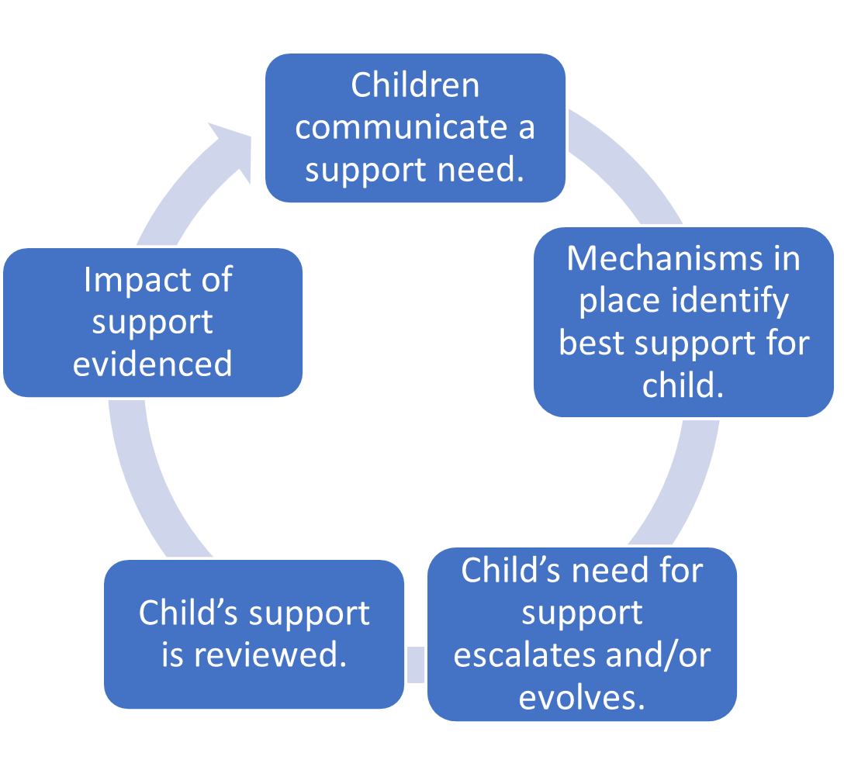
Next Steps
Notes:
Engaging the whole school community (staff, students and parents) is a key strategy to promote pastoral care in schools. Clemett and Pearce (1989) state that pastoral care is effective ‘when everyone in the school community knows, and feels secure in the knowledge that as valued members of that community, they can participate in giving and receiving encouragement, guidance and support’. Policies and programmes need to provide opportunities for staff, students and parents to be involved in making decisions, being heard and making a contribution to the community (Bernard, 1996).
A review of staff wellbeing will enable the assessment of the appropriateness and effectiveness of current systems, structures and services in the school that provide support in this area. Staff wellbeing can be enhanced through professional learning, celebrating staff strengths and achievements, policies to prevent and reduce staff stress, encouragement to collaborate with other staff, and access to professional advice (Cefai & Cavioni, 2014), (Cross & Lester, 2014), (Howieson & Semple, 2000). If staff wellbeing is cared for, then staff are more able to care for student wellbeing.
According to Cross, Lester and Barnes (2014), students present a socially relevant and accurate depiction of the quality of pastoral care provided in their school, hence their involvement in the review process is essential to guide school improvement. The review could assess student wellbeing using the four critical components of pastoral care: promotion of health and wellbeing; resilience; academic care; and social capital within the school community (Nadge, 2005). A variety of standardised reliable and valid measures can be used by schools to conduct this assessment.
Present the purpose, process, major findings and recommendations from a review to the staff and other members of the school community. To ensure ongoing engagement, support for and sustainability of pastoral care within the whole-school community, community members need to be updated regularly on the pastoral care activities and processes being implemented.
Schools have access to many different sources of data: academic, behavioural and attendance as well as student, parent and staff satisfaction surveys. These data can be used to measure the predictors of or the effectiveness of current pastoral care practices. Quantitative and qualitative data can be collected from all levels in the school - the whole-school level (senior executive team), from house or year groups, as well as tutors, students and parents and carers.
Pastoral care policies and practices can be mapped against the schools’ strategic plan and key pastoral care outcomes in order to identify existing overlaps and gaps. This stage also assesses the appropriateness and effectiveness of current systems, practices, policies and services, and the extent to which these achieve the identified wellbeing outcomes.
Teachers and other school staff need to clarify their understanding of their pastoral care role, and how their own actions, and their relationships with students, can enhance or harm the wellbeing of students (Best, 2002). This ‘academic care’ is influenced by: personal qualities of teachers and their relationships with students; the curriculum and its ability to promote meaningful participation and positive learning experiences; the school’s organisational structure and its ability to offer safety, support, trust, guidance and challenge; and links with the broader community.
Determination by staff of what is currently working well, what’s not working well, what’s missing and what’s promising in the school is essential, especially given the limited resources for pastoral care. This decision making may consider policies and practices related to the five key pastoral care school-level tasks: proactive, preventative pastoral care; developmental pastoral teaching and learning; the supportive/collaborative environment; reactive casework; and the management and administration of pastoral care (Department of Education, 2001).
Careful delineation of the roles and responsibilities of all members of the school community to promote a safe and supportive environment needs to be explicit, clearly understood by all and disseminated widely and often. This understanding reduces the pastoral care burden often experienced by pastoral leaders within the school, and encourages students, staff and families to recognise how much they can contribute to a positive, safe and supportive school culture.
Sufficient staff capacity and resources are needed to successfully align and integrate the outcomes of a pastoral care review into the school’s vision and strategic plan. A pastoral care ‘master plan’ can be used to guide and monitor the ongoing implementation of recommendations to the school community.

Slide 9
Dealing with Low Level Concerns
Sue Bailey
Strategic Safeguarding Lead
The Arthur Terry Learning Partnership
Session 3.2

Slide 10
Out line of the session
Raise awareness of what low level concerns are
How do they differ from other concerns
What should our response be
Brief look at the theory
Some recent case studies
Time for questions

Slide 11
What are Low Level Concerns?
Allegations against staff feature in Keeping Children Safe in Education 2023 , Part Four Pages 87 to 105
Pages 87 to 100 look at allegations that meet the threshold for harm
Pages 100 to 105 look at allegations that do not meet the threshold for harm
These are what we now refer to as Low level concerns

Slide 12
So what is a low level concern?
Fundamentally a concern that doesn’t meet the threshold for harm
There is no universal definition of what we mean by harm
The term ‘low-level’ concern does not mean that the concern is insignificant
A low-level concern is any concern – no matter how small, and even if no more than causing a sense of unease or a ‘nagging doubt’ - that an adult working in or on behalf of the school or college may have acted in a way that:
Is inconsistent with the staff code of conduct, including inappropriate conduct outside of work
Does not meet the harm threshold or is otherwise not serious enough to consider a referral to the LADO
All about context and culture
So important to us as DSL’s

Slide 13
Examples of low level concerns from KCSiE 2023
Examples include, but are not limited to:
Being over friendly with children
Having favourites
Taking photographs of children contrary to school policy
Engaging with a child on a one-to-one basis in a secluded area or behind a closed door
Humiliating children
Such behaviour can exist on a wide spectrum, from the inadvertent or thoughtless

Slide 14
What about context. All staff must know
Need to be clear on what constitutes harm and what we then do when this happens
Aware of statutory need to report
Involvement of the LADO, perhaps Police and DBS service
Clear expectations for staff around conduct
Includes all staff ,supply staff , agency workers, volunteers , PTA , contractors , catering staff and cleaning staff
All staff need to know how they should behave and how they should expect other staff to behave
They must know they should report any concerns

Slide 15
How do we encourage this ? It is all about culture
Need to develop a culture of safeguarding first
Putting the child at the centre of everything we do
Understanding it could happen here
Constant training and reinforcement
Need a culture that facilitates disclosures and self reporting
Encourage Staff and student voice
Develop Parental voice
Culture of listening
Culture of reporting
Be clear on boundaries and what constitutes a boundary violation
Avoid bystander apathy
Develop an open and transparent culture of reporting and support

Slide 16
What do we know about professionals who offend
There is no such thing as a typical abuser
You can’t spot them
Some are preferential , some situational some opportunistic
Men and women abuse
All identify vulnerable children to target, those with disabilities ,recently bereaved , living in poverty ,isolated ,LAC, poor family relationships or abused already
They will groom those adults around the child including parents, peers and other professionals and the local community

Slide 17
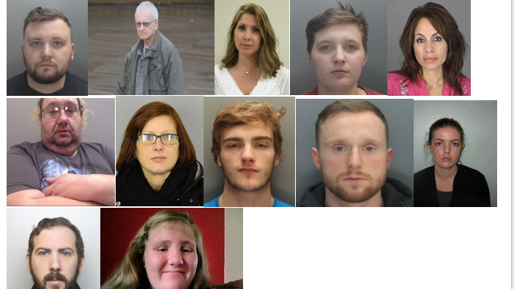

Slide 19
An assistant head teacher living in East Staffordshire has has been caught with more than 11,500 child abuse images following a National Crime Agency (NCA) investigation.
Gareth Mellor, 43, who now lives in Uttoxeter, was also the safeguarding lead at the high school he worked at in Wakefield, Yorkshire.
He was tracked down by NCA investigators after making a Bitcoin payment for indecent images of children via an encrypted cloud storage service.
An assistant headteacher has admitted a catalogue of child sex offences.
Gareth David Mellor was caught with a huge stash of photos and videos depicting the horrific abuse of children, mainly teenage girls.
Officers downloaded the contents of his two cloud storage accounts, and a forensic review revealed more than 11,500 indecent images and videos of children in categories A-C (A being the most extreme). The images, which had not been taken by Mellor, were predominantly of teenage

Slide 20
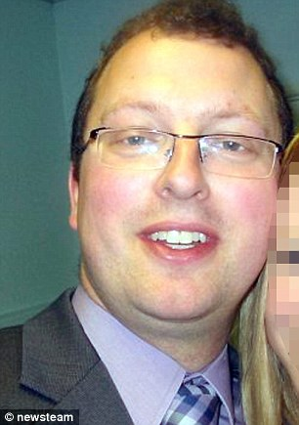
Primary school is put on special measures after allowing a teacher who previously jailed for grooming a teenage girl, 16, to work as a classroom volunteer
Teacher Craig Lindsay jailed for 15 months in 2011 for grooming a girl, 16
He performed sex act on webcam and sent explicit messages to schoolgirl
But primary school half a mile away hired Lindsay as classroom volunteer
Picknalls First School in special measures for failing to keep its pupils safe
Ofsted said
‘The school’s leaders did not follow the statutory safer recruitment practices before allowing a volunteer to work with children in the classroom. A risk assessment had not been suitably undertaken or recorded, nor advice sought from the local authority before allowing the volunteer into school.’

Slide 21
Other case studies
Martin Goldberg
Nigel Leat
Jonathan Thorpe
Vanessa George
William Vahey
Jonathan Thompson Glover
Bruce Roth
Similarities between them all

Slide 22
Case study - Before low level concerns. At what point does this cross the line ?
TK was a talented teacher . There were some odd comments on his reference but his lesson was brilliant
The reference rated his relationships with students as average . There were some concerns about his social media posts. A DHT was to keep an eye on him.
His results were good . He was very helpful . Did lots of duties . Went on lots of school trips . Always bought biscuits .
He had a Y7 class that he was very fond of . He asked to keep this group.
When these children were in Y11 a colleague noticed he was working late , one to one ,with a member of this class, often several hours after school had ended
His HoD thanked him for the extra time he was putting in . He made repeated phone calls home to the child’s parents who expressed their gratitude .
Another colleague saw him leaving school after 6 one night with the student .He felt uncomfortable due to their body language.
There were some anonymous comments on the schools SHARP system from students suggesting a child was in a relationship with a teacher
Some of her friends came and said they were worried about her . She had an obsession with a teacher . She had changed her routines and no longer spent time with them
The teacher was spoken to . He vehemently denied any inappropriate actions . Said he was trying to help, was shocked that his actions could be perceived as inappropriate
Parent were spoken to and the student . Parents were angry saying that their daughter would never be involved in such a way
One evening after school he took her to a local park where he sexually assaulted her . She disclosed this to a teacher
She refused to give evidence against him but enough evidence was gained from other students and teachers to see him banned from teaching for life
Had we been more aware of low level concerns then we might have prevented this harm.

Slide 23
Low level concerns examples from recent practice
PE teacher loosing his temper with his football team (caretaker )
Staff member searching on the internet for pornography (Smoothwall alert)
Staff member working late after school with a child one to one (staff member )
Member of staff calling a child an inappropriate name ( teaching assistant)
Staff member taking photographs of children with their own phone (self reported)
Staff member walking into a girls dormitory when girls in a state of undress (self reported)
Staff member buying gifts for some members of their class (school reception)
Teaching Assistant meeting a child on a Saturday to receive a gift (parent )

Slide 24
A little theory. The slippery slope!

Slide 25
So what should staff do if they are worried
Need to have a Low level concerns policy that gives clear advice
Any concerns must be shared , sometimes with the DSL or Values Champion but with the HT who is ultimately responsible
This must be clearly stated in your policy and all staff must know what to do
The HT will decide the appropriate course of action
It might be a LADO referral or call for advice
It might be support with say a better understanding of the Staff Code of Conduct or Behaviour management or appropriate use of the internet
Can be part of your Safeguarding policy /Staff Code of Conduct policy or separate
Must have clear links to HR and other policies such as Staff Conduct and Whistle blowing

Slide 26
Other sources of advice
Farrer and co
Legal firm but have an excellent Low Level Concerns model policy and a variety of case studies
Book by Marcus Erooga Towards Safer Organisations

Slide 27
Guidance for safer working practice for those working with children and young people in education settings February 2022

Slide 28
Guidance for safer working practice P17.
Any sexual behaviour by a member of staff with or towards a pupil is unacceptable. It is an offence for a member of staff in a position of trust to engage in sexual activity with a pupil under 18 years of age5 and sexual activity with a child could be a matter for criminal and/or disciplinary procedures. Pupils are protected by the same laws as adults in relation to non-consensual sexual behaviour. They are additionally protected by specific legal provisions
This means that staff should:
not have any form of sexual contact with a pupil from the school or setting
avoid any form of touch or comment which is, or may be considered to be, indecent
avoid any form of communication with a pupil which could be interpreted as sexually suggestive, provocative or give rise to speculation e.g. verbal comments, letters, notes, by email or on social media

Slide 29
What happens next
Head teacher will decide if the concern meets the threshold for harm
If any doubt , consult
May be that it doesn’t but there have been numerous concerns
If it does ,phone call to the LADO for advice
We always involve HR at this stage as well
It will often be a conversation with the staff member
Support or training maybe offered in terms of what is acceptable behaviour and what is not
A log must be kept to record the incident
HT should analyse the log in order to identify trends or the need for whole staff training
May be included in report to LGB

Slide 30
What about self reported concerns
Always remember and stress with staff that an abuser wouldn’t report
So , a staff member reports that they have accidentally accepted a child as a friend on social media
A staff member reports that a child was really upset and they gave them a hug
Encouraging that culture of reporting , acknowledging how difficult it might be to come forward is really important
Important to acknowledge this and thank those who do come forward
It is all about culture !

Slide 31
What happens to the record?
KCSiE 2023 very clear
Concerns about supply staff or contractors should be reported to their employer
All concerns should be in writing
Details kept confidentially
Reviewed so patterns can be established
Up to schools how long they keep them but should be kept until they leave their employment

Slide 32
References?
Part three of the guidance is clear that schools and colleges should only provide substantiated safeguarding concerns/allegations (including a group of low-level concerns about the same individual) that meet the harm threshold in references
Low-level concerns should not be included in references unless they relate to issues which would normally be included in a reference, for example, misconduct or poor performance
It follows that a low-level concern which relates exclusively to safeguarding (and not to misconduct or poor performance) should not be referred to in a reference
If in doubt consult HR

Slide 33
Let’s finish with some more music. But what about Abba Was a child harmed ?
Identify the bands
There are two!
Identify the TV show that the piece featured in
Identify the musical that one of the songs is in
Identify the Shakespeare play that this musical was based upon

Slide 34
Questions

Slide 35
Supporting the Trans Community
Dr Jon Needham
Director of Safeguarding
Oasis Community Learning
Session 3.3

Slide 36
Agenda
Why do we need to consider this group of students?
Statistics
Definitions
Legislative Framework
Transgender & the Law
The Equality Act 2010
DfE Guidelines
Steps to consider within your Academies
What this presentation isn’t is an in-depth look at trans rights and a
discourse on modern society. It is looking at the practical steps we need to
take to ensure that a group of students feel included and welcomed into
your provision.

Slide 37
DfE 5 Overarching Principles *
‘Social transitioning’ - defined this as “actions such as changing names, uniforms, or using different facilities to help a child appear more like the opposite sex, with the expectation that they will be treated as if they are”.
Schools and colleges have statutory duties to safeguard and promote the welfare of all children
Schools and colleges should be respectful and tolerant places where bullying is never tolerated
Parents should not be excluded from decisions relating to requests for a child to ‘socially transition’
Schools and colleges have specific legal duties that are framed by a child’s biological sex
There is no general duty to allow a child to ‘social transition’

Slide 38
Why this student cohort?
64% of trans pupils – are bullied for being LGBT in Britain’s schools;
80% of trans young people have self-harmed;
40% of trans young people have attempted to take their own life;
10% of trans pupils are subjected to death threats at school.
I’d been bullied in the past so it was just part of my existence. I started getting death threats online after I came out.
I’ve constantly been the victim of online Abuse and it’s always anonymous. It made me feel violated and awful, it created an overwhelming sense of guilt towards being trans, and increased
the hatred I had for myself
Taken From: SCHOOL REPORT - The experiences of lesbian, gay, bi and
trans young people in Britain’s schools in 2017. Stonewall

Slide 39
Sex or Gender?
The terms ‘sex’ and ‘gender’ are often used interchangeably but have different meanings.
SEX - refers to the classification assigned at birth, based largely on external reproductive characteristics and genetic make-up.
GENDER - refers to the construct of an individual’s identity and self-representation. Gender is defined by the individual, as they seem themselves.
Non-Binary – refers to a person who does not identify as exclusively male or female but may feel like they're a blend of both genders, or they don't identify with either gender.
Transgender identity is not a sexual orientation, but a definition of gender.

Slide 40
Transgender & the Law *
The Equality Act 2010 outlines that gender reassignment is one of the 9 protected characteristics identified in law that cannot be discriminated against.
To be protected from gender reassignment discrimination, people do not need
to have undergone any specific treatment or surgery to change from their birth
sex to their preferred gender.
This is because changing gender attributes is a personal process rather than a
medical one.
A person can be at any stage in the transition process – from proposing to reassign
gender, to undergoing a process to reassign gender.
GDPR legislation places the child over 13 yrs as their data controller

Slide 41
Reflection
‘In the same way that we would not tolerate discrimination in terms of nationality, religion or colour – neither should we permit discrimination in terms of
gender or sexual orientation.
We can’t pick and choose our acceptance of discrimination – it is either all or nothing.’
Take time to think and discuss how your organisation stands against discrimination for other of the protected characteristics and could you do better.
If you are following this course with colleagues share examples where
prejudice & discrimination have been or are being addressed.
It is true that we can always do better, but our intention should be to
Include everyone in our provision.

Slide 42
Involvement of Parents *
Informal Discussion
Disclosure to a Trusted Adult
Exploring the concepts
Gender Identity not linked to Transition
Not to ‘push’ the concept
‘Watchful waiting’
Formal Notification
Discuss with parents – exceptional may circumstances exist (ethical/spiritual/moral objection)
Parental awareness
Consider differences in Primary & Secondary approaches
Maintain legal requirements

Slide 43
Registration
Under 13 years of age - registration of pupils as transgender will be under the instruction of the persons holding Parental Responsibility (PR).
Where the child under 13 years requests a re-classification of gender identity, but the parents don’t agree then the parent’s instruction will be followed.
13 years -18 years old the rights of those holding parental responsibility supersede those of the child.
There is no requirement to retrospectively change student records
However, any formal report written about the child should refer to their chosen name and gender identity but note previous designation where needed.
Schools should make sure that all relevant staff are aware of a gender questioning child’s biological sex.

Slide 44
Parental Disagreement
Transitioning is a huge decision for the student and their family, and it is hoped that it is undertaken with the support of the family. However, there will be occasions when transition is proposed by the student but disagreed with by one or both parents.
Where conflict exists student support will be offered, and an assessment of any safeguarding needs will be made by the DSL.
Where the child requests a re-classification of gender identity, but the parents don’t agree then the parent’s instruction will be followed.
Where conflict is noted between those who hold Parental Responsibility, the permission of only 1 parent is required. The view of the parent where the child is resident will be dominant.
The importance of supporting the teenager’s right to self-expression needs to be considered. The Academy will work to offer support to both the pupil and parent/carer to attempt to achieve a compromise.

Slide 45
Support in the Academy
Actions:
Single Point of Contact – A named member of the Pastoral Team to support the pupil with any academy-based issues or concerns;
Offer in-house emotional health support;
Time given to attend any counselling or external support group appointments;
Recording appointments in your MIS as an authorised absence
Support to Parents
Who in your setting is best placed to be the
named person offering support?

Slide 46
Names & Pronouns *
The draft guidance states that primary children “should not have different pronouns to their sex-based pronouns used about them”.
For older children, schools should only agree “if they are confident that the benefit to the individual child outweighs the impact on the school community”.
Choice of a name is a right and so is compliance expected?
Should pupils be known by the name, prefix and pronoun of their gender identity?
Mistakes (and they will happen) should be apologised for.
Should the refusal to use chosen name and pronoun
be considered as transphobic bullying?

Slide 47
Uniforms *
DfE New Guidance says:
‘A child who is gender questioning should, in general, be held to the same uniform standards as other children of their sex at their school and schools may set clear rules to this effect.
Many schools have a unisex uniform that can be worn by both sexes or offer significant flexibility, so allowing a child to change their uniform may be relatively easily accommodated.
Schools may agree changes or exceptions to the standard school uniform for most uniform items, but not for swimwear.’
Therefore, should Trusts:
Avoid specific boys’ and girls’ uniforms – aim for a gender-neutral uniform
Allow sports kit that aligns with gender identity
Does your setting place any gender-based requirements on clothing,
uniform or hair styles? Does anything need to change?

Slide 48
Trips, Toilets & Changing Facilities
‘Only after the school has considered relevant factors outlined above, alternative
arrangements should be sought’
To this end facilities should, where we can:
Offer gender neutral toilet facilities;
Floor to ceiling doors toilet & changing room cubicle doors;
Fully working door locks;
PE changing cubicle options if possible;
Rename ‘disabled toilet’ to ‘unisex toilet with access’
Transgender students should not be directed to use the disabled toilets
Overnight trips should specifically consider transgender students
This is often the most difficult to accommodate. How will you make this work in your setting? How will you safeguard the pupils?

Slide 49
Teamwork and Group Challenges
Where possible:
Avoid ‘Boys verses Girls’ challenges
Avoid gendered groups e.g. ‘All the boys to this side, all the girls to the other.’
Reading books for boys & books for girls.
Should we consider avoiding gendered terms e.g. Head Boy & Head Girl
Gender specific sports only when necessary
This often happens unconsciously, take a walk around your setting and see if there are any examples of gendered activity.
How can you change the culture in your Academy?

Slide 50
Disclosure & Press Enquires
Pupils' confidentiality is protected under GDPR and Equality Act legal rights
Disclosure of transition to whom, by whom, how and when, will be carefully and sensitively managed by the Senior Leadership. This will include communication to class teacher, pastoral staff and support staff
Press enquiries about transgender provision within a single academy will be declined so that any additional attention will not be drawn to the individual pupils.
Freedom of information enquiries about and transgender provision would be reviewed on a case-by-case basis.
If the enquiry relates to an individual, then a GDPR exemption
would apply.
If the enquiry related to transgender issues generally a decision
to respond would be taken on its merits.

Slide 51
Case Study – what would you do
You are observing the teaching of a maths lesson.
On the worksheet there is a question about a survey divided by girls & boys.
A student at the back of the classroom, with a smirk on her face loudly asks another student (who identifies as non-binary) “So where do you fit in weirdo?”.
What actions could you take to manage this situation?
How would you record this event?
Who would you report it to?
What sanction and support would you expect to take place?

Slide 52
Next Steps
Do you know if you have any Trans Students in you school?
How is diversity reflected in your lessons especially the new RSE curriculum?
What steps do you need to take to make your own practice more gender neutral?
How do you record episodes of transphobic bullying or harassment?
How are you going to make your setting more inclusive?
Action:
As a personal measure of solidarity and support - could you put your
pronoun choice in your email auto-signature?

Slide 53
Supporting a
transitioning student
All done in consultation with the student and according to their timeline
Student comes out to a member of staff
Inform member of ALT and DSL
Discussion with student. Do they wish to socially transition at school?
Yes
No – regular pastoral support and offer of parental outreach
Permission given - signpost to trans supporting charities e.g., Mermaids etc.
Parental meeting (DSL/Teacher/ALT/Pastoral) to seek social transition permission
Permission NOT given - regular pastoral support, close watch on mental health
Permission given: staff meeting with Pupil, Parents and connected teaching staff re: name/pronouns and connected decisions e.g., sports teams, gendered activities, RSE lessons
Regular keeping in touch meetings with parents facilitate family understanding and/or tolerance
ALT discussion re: changing & toilets. Paperwork completed for permission and to inform
Change (preferred) name on MIS system and add pronouns
LGBTQ+ staff training, including reporting transphobia on MIS / Safeguarding records
Ongoing Pastoral support
Form time lesson & conversation with peers
(at student’s choice)
Inform all connected support staff of change or name/pronouns
Regular keeping-in-touch meetings with parents

Slide 54
"You never completely have your rights, (as) one person, until you all have your rights."
Marsha P Johnson
1945-1992
Trans-activist
Founder Member of Stonewall USA
Marsha was a prominent fixture in the LGBTQ
community serving as a “drag mother” by
helping homeless and struggling
LGBTQ youth

Slide 55
Questions

