Slide 1


Stream 1 - Referral
Presenters:
Jane Daniel – Oasis Academy Trust
Nicola Law – Liberty Academy Trust
Matt Cannon – Oasis Academy Trust
Session Number

Slide 2

Writing Effective Referrals
Jane Daniel
National Safeguarding Lead
Oasis Education
Session 1.1 - Warwick

Slide 3

The Statutory Guidance
Keeping Children Safe in Education (2023) states that:
The DSL is expected to refer cases:
of suspected abuse and neglect to LA children’s social care
to the Channel programme where there is a radicalisation concern
to the DBS when a person is dismissed or left due to harm/risk of harm to a child
to the Police when a crime has been committed

Slide 4
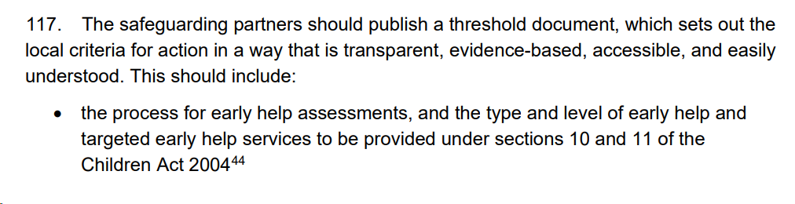

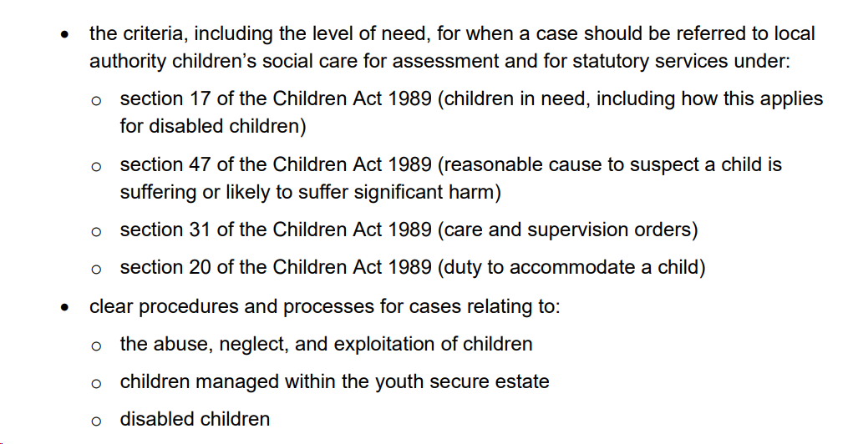
The Statutory Guidance
Working Together to Safeguard Children (2023), states:

Slide 5

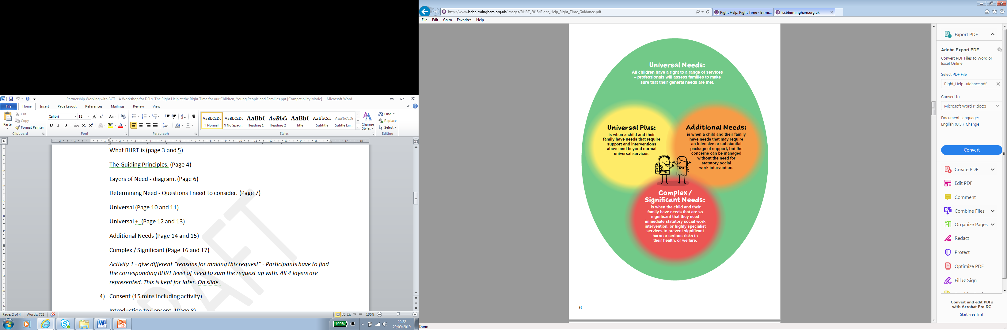



Threshold Documents

Slide 6
Threshold levels
LEVEL 1
Should be met within universal settings; including low level additional needs.
LEVEL 2
Which meet the criteria for more formal targeted services delivered as part of the early help offer; multi-agency intervention, a lead professional and a team around the family approach in addition to support in universal services Universal Plus will be shared with Early Help partners who are located within MASH.
LEVEL 3
Which meet the threshold for social work assessment and support under S.17 Children Act 1989 (child in need) Additional concerns are addressed by Family Support who are located within MASH. This includes Think Family intensive providers.
LEVEL 4
Which meet the threshold for statutory child protection by social work teams delivered under S.47 Children Act 1989, in addition to provision in universal settings and by targeted services. This may also include children subject to a Care Order or children looked after under S.20 (duty to accommodate) of the Children Act 1989. Complex and Significant concerns are addressed within Children’s Social Care.
Notes:
Depending on the Local Authority Threshold guidance this could be referred to as Level 1 – 4 or Universal needs to Complex Significant.

Slide 7
Determining Need –
Questions I Need to Consider
What are the strengths of the family and what is working well?
What are my worries?
What are the future dangers for the child?
What did the child say or communicate about these worries?
What did the family say about these worries?
Has their response helped my decision making?
What is the picture of the family as a whole?
What are the needs of any siblings and parents?
What advice and support have I offered the child and their family?
What are the complicating factors making the problem more difficult to deal with?

Slide 8
Determining Need –
Questions I Need to Consider
What is the advice from my line manager or safeguarding advisor?
What is the view of other professionals involved with the
child/family?
What help does the family need? Does the family consent to sharing information?
Does the family agree to an offer of help and support?
What action will I take if consent is not given and what will the impact be for the child if action is not taken?
The purpose of these questions is to have a better understanding of the child and family’s lived experiences. Be curious; put yourself in the child’s place. Recognise that views and interests may differ. Treat all family members with respect and show empathy.

Slide 9
Consent and information sharing
Practitioners who believe a child or family requires help have a responsibility to discuss this with the family and where possible agree a way forward with them. This will ensure that parents are aware of worries and of what information will be shared. Children and families have a right to confidentiality, and we should always seek their consent and cooperation where we want to share information about them with others. However, if you consider a child is likely to or is suffering from significant harm, consent is not needed to share information or make a referral to Children’s Social Care via MASH. You have a duty to share in these circumstances.
In some situations, it will not be clear that a child is at risk of significant harm, but it is apparent that their safety may be at risk. In these circumstances sharing information without consent may still be appropriate. If this is the case it is still good practice to discuss your worries with the family, unless you consider this would put anyone at greater risk of harm.

Slide 10
Consent and Information Sharing
Key principles:
We are committed to gaining the informed consent of children and/or parents when we wish to share confidential/personal information.
2. We will respect the wishes of those who do not give consent, except where safety may be at risk or when it is inappropriate to seek their agreement.
3. In each case we will record the: necessity; proportionality; relevance; adequacy; accuracy; timeliness; and security of the information shared. We will take reasonable steps to obtain consent, and if it is not given, we will record why we believe safety may be at risk, or why it was inappropriate to seek their agreement.
Notes:
Parental consent: Advocate for families. You need to be able to form good relationships but also have difficult conversations - keep the balance right! Working with families and involved parties can be stressful and upsetting at times as emotions can be high, recognise your own triggers and unconscious bias.

Slide 11
S47 child protection enquiry
“Where a local authority has…reasonable cause to suspect that a child who lives, or is found, in their area is suffering, or is likely to suffer, significant harm, the local authority must make enquiries or cause enquiries to be made”

Slide 12
Referral Data
598k referrals were made to children’s social care in the year ending 31/03/21
which was a 7% reduction on the previous year,
of which, 136k were re-referrals within a year
81k referrals from education settings,
of which, 29k were either NFA or did not meet threshold (36%)

Slide 13
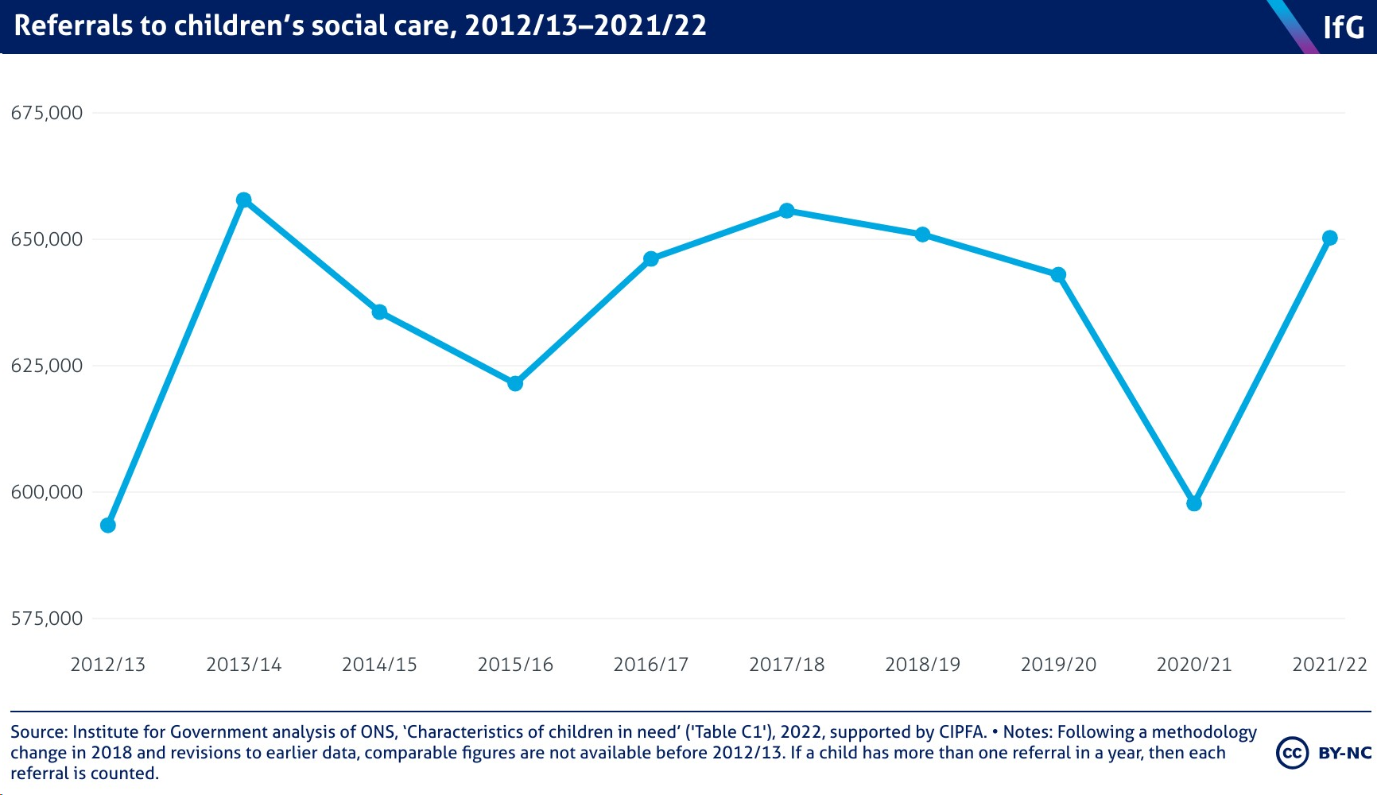
Referral Data

Slide 14
Overview of a Multi-Agency Safeguarding Hub
Example of a MASH-
MASH receives both telephone calls and emails from professionals, parent/carers and members of the public
The telephone service receives between 200-250 calls per day. The service also receives between 250-300 emails per day.
When emails are received by MASH they are filtered by staff from MASH Business Support. MASH receives a percentage of emails that need to be dealt with by other teams or services.
Concerns about children where there is already a children’s social care or Family Support case open on the CSC system.
Concerns about children outside the area
Enquiries that have come to MASH in error e.g. Adoption and Fostering, SENAR etc.
MASH Business Support redirects these emails to the appropriate team, service or other Local Authority. MASH Business Support also deals with basic requests for information from professionals and can inform them whether a child/family is known to Children’s Social Care or Family Support and whether the case is open.

Slide 15
Example of what happens when you contact the MASH front door?
Contact is made
Telephone contact – Referral and Advice Officer
Request for Support
Social Work oversight
Social Worker looks at referral – decision made against local threshold guidance, rationale, outcome
Action for MASH, ASTI, FS, TF, Agency EHA or NFA
Feedback to referrer
Feedback is sent to referrer
Referrer or other agency may be directed to complete an Early Help Assessment
Other contact (email, other agency format)
Partner agency information gathered

Slide 16
Example of a MASH
The following staff are based within A Social Care Referral Centre:
4 Social Work Team Managers
18 Social Workers ( including Senior Practitioners, Senior Social Workers, Social Workers)
1 Family Support Team Manager
1 Family Support Practice Supervisor
1 Operations Team Manager
3 Team Leaders
24 Referral and Advice Officers
Business Support Staff
A number of partner agencies also are located within MASH –Adult mental health; Police; Health; Disabled Children; Children Centres for Mental Health Support, Probation, Change Grow Live (CGL), Child Criminal Exploitation Team, Probation Service Youth Offering Service, Education Officers, Teenaged Pregnancy Coordinator, Early Years Early Help, No Resource To Public Fund’s Team, Children’s Centres and Women’s Aid.

Slide 17
Rising thresholds?
In an inquiry by the National Children’s Bureau (NCB) for the All-Party Parliamentary Group for children:
“70% of… social workers [report] the threshold for helping ‘children in need’ had risen, … while half said the point at which a child protection plan was triggered had gone up”

Slide 18
Why ‘no further action’ & ‘not met threshold’ ?
A lack of understanding of local thresholds on the part of the referrer
The challenges of parental engagement
Some referrals lack detail
Information which informs assessment is often missing
The voice of the child is not included
…and we might consider that the reduced capacity in services, a rise in thresholds and the expectation that schools will increasingly provide their own Early Help
It is assessed there is currently a £1.6 billion funding gap in children's social care

Slide 19
What can DSLs do?
Have a good understanding of the legal framework
Have knowledge of local thresholds
Have a shared understanding of the pressures
Understand their local community context
Take a structured approach to writing referrals; use a referral checklist
Use tools to assess risk and inform referrals
Maintain open communication
Use escalation procedures (next session)

Slide 20
What makes a good referral
Good, clear use of the local threshold guidance in “Why are you making this request?” section.
The voice of the child is clearly represented, what the child has said or experienced is included in precise detail.
The concerns that you have are evidence based.
Other agencies involved with the child are included – for example the GP, agencies that may be supporting the child in school etc.
Consent has been sought and if it has not been sought, the reason is fully explained.
You need to clearly explain what needs to happen next and why?

Slide 21
What makes a poor referral?
Often professional disagreements can stem from poor referrals. What makes a poor referral?:
  Local threshold document is not referenced.
  The concerns are not always evidence based. A lot of speculation is included.
  No other agencies are included in the referral.
  It is not always clear that consent has been sought.
  There is no explanation as to what needs to happen next.
  Far too much previous history or a chronology is put into the form – current concerns / risks need to be made clear.
  Opinions and judgements of the professional completing the form come through.

Slide 22
Referral Checklist
Make clear who you are, what your role and relationship is to the child you are making the referral about
State the source of your concern and be clear what is fact and what is opinion. Reports should distinguish clearly between facts, such as investigation and examination findings, observations, such as those relating to demeanour or personal hygiene, and opinion such as those about relationships.
Include the child's thoughts and feelings about what is happening to them and what they would like to change. Use as much of the child's language as possible.
Explain medical terminology/SEND information and what this means for the child as the reader of the referral may not have any medical background.
Describe and explain your concerns in as much detail as possible. Give a clear outline of why you are concerned, for example what is happening, or not happening, that is causing concern or impacting on the health and/or safety of the child; this may include a short chronology of significant events. Be clear about what type of abuse you think may be happening. Include what is going well for the child/family and who is currently supporting them.

Slide 23
Referral Checklist
State how the referral meets the local threshold for referral; include contextual issues. For example, concerns about parental mental illness, substance abuse, domestic abuse, a chaotic lifestyle or missed appointments. State whether or not an EHA (Early Health Assessment) has been undertaken and any difference this has made (although this is not a prerequisite for a child protection referral).
State who lives in the household and the relationship of these individuals to the child and to each other (a genogram* can be useful). Consider whether there is anyone else at risk for example, other children or vulnerable adults, and state this and who they are.
State whether the situation/referral has been discussed with the child and/or parents (which is expected practice, unless it is thought that to do so would place the child at additional risk). State whether consent has been obtained.
State what actions have been taken by the referrer, including discussions with other relevant health professionals, practice leads or named professionals.

Slide 24
Challenges we face when making referrals to social care…
You will have the evidence, to include in your referrals, of the work the school has already undertaken; signposting, interventions, referrals to other agencies etc.
You will be able to evidence what has worked well and what is still not working.
You can assess concerns with the involvement of other staff and other agencies.
NFA/not met threshold:
36% nationally
…all of which should increase the potential for your referral to be accepted by social care for assessment and allocation of a worker
Notes:
Multi agency working: Escalation and resolution for professional disagreements. DO NOT be afraid to push back to SS /CS as needed and escalate if you have concerns - note these down in an email, record on pupils safeguarding records. Ensure you have read the threshold guidance and are able to use this when asking for further support.
Early Help: Are we effectively monitoring the impact of our internal Early Help offer (e.g through our Hubs) and are we effectively securing local support at the right time (What is your local offer for Early Help support and is it being fully utilised)? What could we do more of or what could we do differently? Is our offer led by the lived experience of the child and family? Is the pupils voice and the parents voice captured and taken into consideration?
CSC Multi Agency Support Hubs: Where level of need is greater than the early help offer do we have evidence of effective multi agency working and escalation where required using the Local Threshold Guidance. Do safeguarding records show this?

Slide 25
Tips for making effective referrals
Use the language!
Based on the concerns and associated impact outlined above, I believe that Child X is suffering of likely to suffer significant harm, requires Tier X support, as outlined in the Safeguarding Partnership Thresholds document, and requires enquiries under S47 of the Children Act 1989.
Based on the concerns and associated impact outlined above, I believe that Child X is unlikely to achieve or maintain a reasonable level a of health or development and/or Child X’s health and development is likely to be significantly or further impaired without the provision of services. I therefore believe that Child X requires Tier X support, as outlined in the Safeguarding Partnership Thresholds document, and would benefit from an assessment under S17 of the Children Act 1989.
Notes:
USE THEIR LANGUAGE! Build those relationships and make contacts.

Slide 26

Questions

Slide 27

How and when to challenge a referral
Nicola Law
Director of Safeguarding
Liberty Academy Trust
Session: 1.2

Slide 28
How and when to challenge
Why challenge?
How to challenge?
When to challenge?
What next?

Slide 29

How and when to challenge
Q: How many of you have disagreed with the outcomes of a referral?
Q: How many of you have challenged the outcome using the formal escalation procedure?

Slide 30
Why challenge?
You disagree with the outcome and believe social care involvement is still required
Your professional judgement is no less important than another professional - we see these children every day
No single practitioner can have a full picture of a child’s needs and circumstances. If children and families are to receive the right help at the right time, everyone who comes into contact with them has a role to play in identifying concerns, sharing information, and taking prompt action (para 3, KCSIE 23)
Best Interests of the child, always remaining child-centred and prioritising their voice

Slide 31
Why challenge?
14. Anyone working with children should see and speak to the child, listen to what they say, observe their behaviour, take their views seriously, and work with them and their families and the people who know them well when deciding how to support their needs.
Practitioners should also be aware that children may find it difficult to always speak about what they need, what is happening to them or what has happened to them. Legal duties under the Equality Act 2010 must be complied with, including putting special provision in place to support dialogue with children who may not be able to convey their wishes and feelings as they may want to. This might include, for example, those who have communication difficulties, unaccompanied children, refugees, those children who are victims of modern slavery and/or trafficking and those who do not speak English or for whom English is not their first language. (WT, 2023)

Slide 32

Why challenge?
150. Anyone who has concerns about a child’s welfare should consider whether a referral needs to be made to local authority children’s social care and should do so immediately if there is a concern that the child is suffering significant harm or is likely to do so (WT, 2023)
  Have all practitioners acknowledged/listened to child’s voice?
  Do we believe the child remains at risk of significant harm or in need of further help?
  Have we evidenced the thresholds have been met to instigate social care intervention? Do we need to provide further information to support the initial referral?
  Do we need to initiate the Escalation Procedure?
  Do we instigate Early Help?

Slide 33
How to Challenge?
151. Feedback should be given by local authority children’s social care to the referrer on the decisions taken. Where appropriate, this feedback should include the reasons why a case may not meet the statutory threshold and offer suggestions for other sources of more suitable support. Practitioners should always follow up their concerns if they are not satisfied with the local authority children’s social care response and should escalate their concerns in line with local procedures if they remain dissatisfied (WT 23)

Slide 34
How to Challenge?
Local escalation protocol - this can be found on your local safeguarding partnership website
Usually set out into 4 stages but timeframes for response are variable from partnership to partnership

Slide 35
How to Challenge?
Stage 1: Direct discussion/challenge – practitioner to practitioner – solution-focused discussion to agree on next steps/action. Scaling discussion. Can request professionals meeting at this stage
Stage 2: Management discussion/challenge – both practitioners refer to their line manager to move to second level of escalation. Management briefed on key areas of disagreement and take responsibility to find solution. This is standard practice
Stage 3: Formal resolution between heads of service – if managers cannot find a resolution at stage 2, escalation to senior management/head of service (Director of Children’s Services and Trust Director of Safeguarding). Breifing documents must be shared, evidence of prior attempts to find a solution through stages.
Stage 4: Refer to the Safeguarding partnership – Lead statutory partners

Slide 36
When to Challenge?
Stage 1: Direct discussion/challenge – within 2 working days
Stage 2: Management discussion/challenge – within 5 working days
Stage 3: Formal resolution between heads of service – within 2 working days
Stage 4: Refer to the Safeguarding partnership – date set within 24 hours of stage 3 outcome – for when a meeting will be held with safeguarding partner/independent chair

Slide 37
When to Challenge?
If your local protocol does not specify timeframes, contact your local safeguarding partnership for clarity
Prepare managers at each stage – ensure they have sight of the local protocol, understand their responsibility and timeframes for response – better to be prepared in advance
Don’t give up!
Ofsted ask specific questions about professional challenge – ensure you clearly record any incidents of professional challenge, resolutions and next steps.

Slide 38
What Next?
Case supervision – case mapping
Request a professional’s meeting – who else is working with the family currently, previously, who else is needed now?
Early Help Offer – building relationships, be honest and transparent about concerns and what Early Help support can provide
Assigning the Lead Professional – be aware of WT 23 update paras 156 and 157.

Slide 39
What Next?
156. Once the referral has been accepted by local authority children’s social care, a social work qualified practice supervisor or manager should decide, with partners where appropriate, who the most appropriate lead practitioner will be and with the lead practitioner’s agreement, allocate them in line with the local protocol.
157. The lead practitioner role can be held by a range of people, including social workers. When allocating the lead practitioner, local authorities and their partners should consider the needs of the child and their family to ensure the lead practitioner has the time required to undertake the role. The lead practitioner should have the skills, knowledge, competence, and experience to work effectively with the child and their family. The lead practitioner should always be a social worker for child protection enquiries. (WT 23)

Slide 40
What Next?
Initiating Early Help:
Don’t assume they won’t engage if they haven’t previously
“It is important to understand the underlying issues giving rise to reluctant or sporadic engagement, particularly where professionals are ‘working with consent’. An understanding of adults’ own experiences is essential to addressing concerns about their lack of engagement.” Child Safeguarding Practice Review Panel (2021)
Be honest and clear about your worries and build a plan together – do “with”, not “to” – SoS approach – Scaling conversations
What will you be doing to support them regardless of multi-agency intervention?
What can others do?

Slide 41

Questions
Session: 1.2

Slide 42

Managing Relationships Post Referral
Matt Cannon
Assistant National Safeguarding Lead
Oasis Community Learning
1.3

Slide 43

Agree or Disagree?
A social worker is more qualified than me to make decisions about a child being at risk of harm?
Notes:
Whilst a social worker is a register professional and social care are often the final decision makers, it does not make them best placed to make a decision. Being a DSL comes with authority and there is value in your professional judgement. Risk is shared between professionals rather than owned by one which removes the power imbalance.

Slide 44
Agree or Disagree?
It is essential to apologise to a family for making a referral to social care.
Notes:
Referrals to social care, especially without consent are often upsetting for families. However, you have clear roles and responsibilities as well as a moral and statutory duty to help keep children safe. We should not apologise for this but perhaps we should acknowledge how difficult the journey ahead for a family might be.

Slide 45
Agree or Disagree?
Relationships are not as important as doing my job and keeping children safe

Slide 46
Agree or Disagree?
We should be completely transparent with families about our concerns

Slide 47
Getting the fullest picture
Known to DSL
Unknown to DSL
Open
What is known and acknowledged by everyone?
Blind
What do agencies or families know that you do not?
Known to partner agencies and / or Families
Hidden
What is known by the DSL but not yet known or shared with others?
Unknown
We cannot know about everything but what do we need to find out?
Unknown to partner agencies and / or Families
Notes:
The Johari Window is a model used to help people better understand their relationships both with themselves, and with others. As such, it’s a useful technique for improving an individual’s self-awareness and development in group situations. It also aids two-way communication with the group.
At its heart, the Johari Window is about getting everybody on the same page. Ultimately, the aim in a group situation should be to expand the top-left pane or ‘open area’. This is the most productive and effective area in which to be working.
This is the arena in which the participant’s attributes are visible and understood by both themselves and their peers alike. As such, communication and cooperation are optimal in this area; whereas conflict, confusion and misunderstanding are minimised.
This simple model can be your guide and self-reflection tool to dip into so you can realise your unique power through:
Improved Self-Awareness: The model encourages individuals to gain a better understanding of themselves by examining their thoughts, feelings, and actions.
Enhanced Communication: By promoting open and honest dialogue, the Johari Window helps in resolving conflicts and misunderstandings, leading to improved communication within teams and groups.
Strengthened Relationships: Building trust and empathy through self-disclosure and feedback fosters deeper and more meaningful connections with others.
Personal Growth: The Johari Window challenges individuals to explore their unknown areas, pushing them to grow and evolve beyond their current limitations.
Further Reading:
Hearing the voices of children and families in supervision, (2019) Practice Supervisor Development Programme, Research in Practice

Slide 48
Getting the fullest picture
Known to DSL
Unknown to DSL
Jason has disclosed that his parents fight and argue a lot. He is often tired and late for school.
Father has left the home last night and mother is being supported by her sister.
Known to partner agencies and / or Families
You have noticed in meetings that mother seems withdrawn and tearful. Jason has been quite controlling of peers in school
How often?
Context of the DV?
Will/when father come back?
What is the impact of the trauma?
Unknown to partner agencies and / or Families
Notes:
Social care do not want to take any further action, the risk has been mitigated by father leaving the home. How do we make all information known?
We can never completely remove the unknown and have to accept an element of risk

Slide 49

Strike Whilst The Iron is Hot
Managing a relationship post referral feels a contradiction in terms.
Without a heavy investment pre-referral, you will be playing catch up.
Invest heavily in the quality of communication and interaction at the point of referral.
Look to engage the parent/carer as soon as you can once you know the outcome of the referral.
We know 9/10 referrals will go to some kind of consent-based service therefore you will remain the lead professional for that family
…
How would you want to be told if your child has made a disclosure?
Notes:
It sets the tone for the relationship going forward

Slide 50
Getting Comfortable With The Uncomfortable…
We may not agree with the outcome of the referral or case closure
Challenging senior managers can be uncomfortable
We may feel uncomfortable if we are the only oppositional voice
We may feel vulnerable if the viewpoint the parent/carer is negative towards us.
We must recognise and accept our own vulnerability and limitations within the whole process.
What would you expect from a conversation with a professional making a decision about your family that you did not agree with?

Slide 51
Acceptance
Acceptance of what is within our control
Acceptance of what is our role and remit
Acceptance of having a human response (including us!)
Acceptance of times we may need to find other ways to move forward
Acceptance that we may now have a breakdown in the relationship with a parent
What would be the key message you would want to convey to a parent/carer in your first discussion post the referral?

Slide 52
Authenticity
Avoid a cosy conversation and soggy emotionalism
Believe in yourself – you have used evidence and professional judgement to come to a decision
Own your decision-making and be transparent. You do not have to own other people’s/agencies decisions.
Backing away and distancing the school from the outcome of the referral may only provide further tension, animosity and ultimately discredit the work you are there to do.
What does your policy/protocols suggest about how you will work with parents and agencies post a referral?

Slide 53
Relate- Restore- Reconnect
Be focussed on the child – how is your relationship now?
Regardless of the outcome of the referral how do you address the uncertainty of what is next?
Minimisation of the level of restoration required will always clearly link back to the level of honesty, transparency and investment given prior to the referral.
We may not be able to make the parent ‘happy’ with us or feel ‘good’ about the action we have taken but we share a common goal – Ensuring the child is safe.
Is it our job to repair the relationship?
Notes:
Don’t be afrid to be compassionate.

Slide 54

Questions

