Slide 1
Stream 2 – Pupil voice
Presenters
Christine Franklin – Academy Transformation Trust
Dan Halls – Sapientia Education Trust / Seckford Education Trust
Patrick Knight – Diverse Academies
Session Number

Slide 2
Child Friendly Referral Routes
Christine Franklin
Director of Safeguarding and Inclusion
Academy Transformation Trust
Session Number 2.1

Slide 3
Practice Reflection
What are the strengths
of your current disclosure routes
for your Young People?
Reflect and make your own notes, or share with those close by

Slide 4
Thought sparkers
The following quotes will spark thoughts about your own Safeguarding Culture and the facilities you have for children to make disclosures
Trigger warning: Some of these quotes talk about abuse, some of the content today will visit topics surrounding survivors reflecting on disclosures and may mention forms of abuse including sexual and physical abuse

Slide 5
“How do you say what you don’t know? Words around sex and child sexual abuse are literally barriers to disclosure in that children do not have the words.” Mental health organisation

Slide 6
“The repercussions are huge, threats to take children away, fear of losing everything and at the hands of white people who don’t understand my culture or beliefs. Disclosing child sexual abuse will make the situation worse, not better. The woman will fear being sent back home and having her children taken away.” Domestic violence charity

Slide 7
“We have had sexually abused boys tell us that they cannot tell anyone because their parents have told them that ‘Boys don’t get abused.’” Organisation supporting the Congolese community

Slide 8
The NSPCC indicated that the average time it takes for a victim of children sexual abuse to talk about what has happened to them is eight years (Allnock and Miller 2013 NSPCC).

Slide 9
"A male student noted that he has tried to talk about his mental health issues with various peers but found that they quickly zoned out and reached for their cellphones. He gained a reputation as a "whiner" and lost friends as a consequence. " Brothers in Arms, Scotland

Slide 10
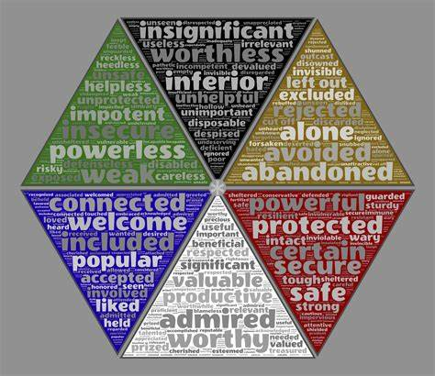
"Children are able to learn and can even thrive when they feel safe" "

Slide 11
"While some children and young people disclose abuse directly and verbally, others attempt disclosures indirectly, behaviourally and non-verbally." NSPCC, "No one noticed, no one heard" report.

Slide 12
"Abused children become experts at not recognizing that their parents are harming them. They are not able to live independently yet, and so they need to remain attached to their parents to survive. This is a primary dilemma for the young who are abused....This is not because they choose to be harmed, but because they have to remain under the care of their abusers to survive." Dr. Patricia Turner, Registered Psychologist

Slide 13
"Findings demonstrate that young people face a number of different barriers such as limited support, perceived negative consequences and feelings of self-blame, shame and guilt, when choosing to disclose. Being asked or prompted, through provision of developmentally appropriate information, about sexual abuse facilitates disclosure." Charlotte Lemaigre et al
Barriers and facilitators to disclosing sexual abuse in childhood and adolescence: A systematic review

Slide 14
Today's Session
Barriers to Disclosure
Safeguarding Culture
Psychological Safety
Verbal Routes
Non-Verbal Routes
Online Routes
Voice of the child and lived experiences
Safe Spaces

Slide 15
Sharing thoughts: What Makes a Child Friendly Referral Route?

Slide 16
Barriers to disclosure
Shame
Language
Awareness
Culture
Threat
Survival
Available disclosure routes
Expected consequences
Notes:
Pressure or threats from the perpetrator
Relationship to the perpetrator
Expected consequences of telling (e.g., physical injury/death, family separation, parental distress)
Pressure from the child's family
Fear of negative reactions from parents or family
Fear of not being believed
Feelings of embarrassment, shame and self-blame
Having no one to turn to

Slide 17
The Tools

Slide 18
Safeguarding Culture
Strategy
Structure
Systems
Skills
Staff
Styles

Slide 19
Psychological Safety
Thrive Global
Notes:
Increases in self-confidence, emotional wellbeing, and cognitive processing
Concerns around ‘identity-management’ decrease as students become less consumed by how they are perceived by others
Students understand learning and growth is done through making mistakes
Active student participation in new experiences, activities, and learning
Students become more open to opportunities for problem-solving and collaboration
Motivation for academic learning increases as students respect their academic journey.
Student wellbeing is negatively impacted, reducing self-esteem and mental wellbeing
Students feel anxiety or anger from concealing their self-expression, in an effort to fit in
Students can withdraw from classroom discussions and projects. Often remaining silent, and seen as passive contributors
Students with great ideas, or out-of-the-box thinking, might not get their time to shine
“Fight or Flight” responses can be triggered when students interpret moments of embarrassment as ‘threats’.

Slide 20
Training: Foundations for Culture
Safeguarding Training
Induction
Updates and Radar
Local Top Concerns
Line Management of Safeguarding
Regular Meeting Agenda Item

Slide 21
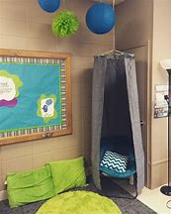
Safe Spaces
Warm Strict Culture
Student Voice
Inclusive Policies (Behaviour, Attendance etc)
Reward and Praise Systems
Emotional Literacy Toolbox
Clubs and support groups that foster belonging and lack judgement
Reflection corners
Social time support spaces
Mental Health First Aiders and Peer Supporter Access
Non-confrontational atmosphere (Busy hands!)
Allowing sensory breaks
Recognising the link between Neurodiverse traits and trauma traits

Slide 22
Emotional Literacy
Being able to articulate emotions, from an early age is beneficial for both students and educators:
Articulate what they are feeling
More likely to disclose
Improved wellbeing
Improved resilience
Less likely to get excluded (SEMH and SLCN two highest occurring needs in students with exclusions in the UK)
Some great intervention packages to trial include: ELSA, Thrive, Draw and Talk
Whole school emotional literacy programs: Zones of Regulation, ELSA

Slide 23
Verbal Routes
Staff training
Drop in sessions
DSL availability and presence
SEMH interventions
Voice of the Child Resources
Check Ins
Play/ Lego Therapy
Peer Supporters

Slide 24
Non-Verbal Routes
Round Robins and Feedback
Trauma Informed Practice
Behaviour Communicating Needs
Therapy (E.g Lego, Play etc)
Worry Monster, Worry Jars
Post Boxes
Student Voice Meetings
Team Around the Child Meetings

Slide 25
Online Routes
BOB emails (Bullying or Banter)
Whisper
Anonymous referrals
Links to other support routes (CEOP, Childline etc)
Safeguarding Emails

Slide 26
When it works?
What made this the space they needed to share what they did?
What, reflecting back on their school days, might have made that point in time the moment that they disclosed?
Has this changed the way you think about current practice?

Slide 27
Questions?

Slide 28
Meeting the needs through effective training
Dan Halls
Director of Safeguarding and Attendance
Sapientia Education Trust & Seckford Education Trust
Session 3.3

Slide 30
Why do we deliver training?
‘KCSIE 2023’
It is more than just meeting our statutory requirement
Keeps children safe
Empowers staff
Feeds your safeguarding culture

Slide 31
Who needs training?
Teachers
Catering
Support staff
Estates
Governors / Trustees
Admin
DSLs
Supply staff
Volunteers

Slide 32
How do you know what training is required?
Statutory requirements
Staff confidence
Concerns
Student voice
Contextual information

Slide 33
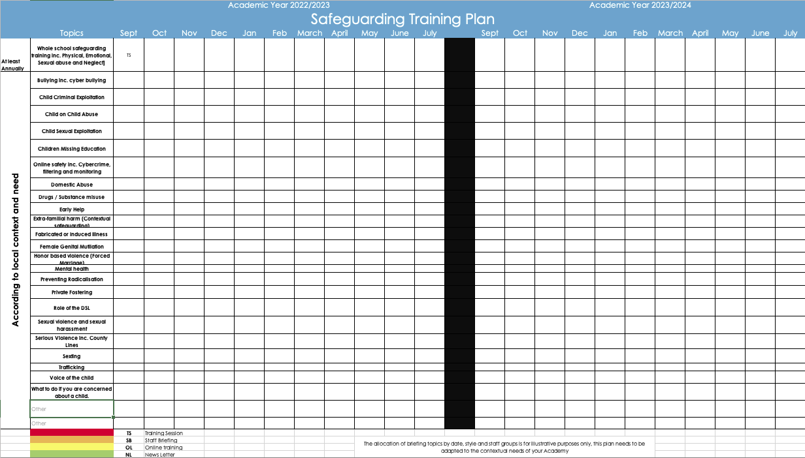
Strategy or on a whim?

Slide 34
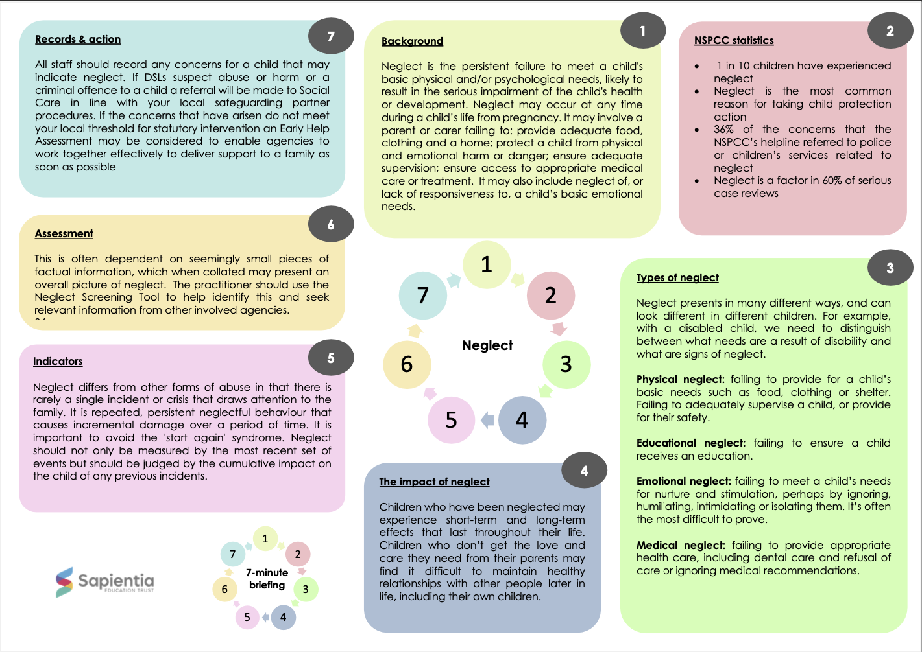
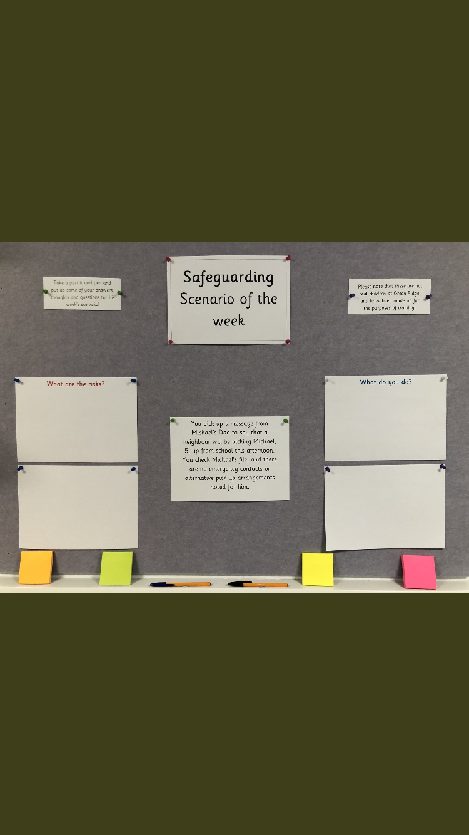
Methods of delivery
In person
Online courses
7-minute briefings
Newsletters
Scenarios
7-Minute
briefings
Online courses
In person
Scenarios
Newsletters

Slide 35
Impact
How do you know the impact of your training plans?
How do you demonstrate the impact to key stakeholders?
Engagement
Quizzes
Scenarios
Concerns
Conversations
Student voice

Slide 36
Questions

Slide 37
Listening to the student voice
Patrick Knight
Strategic Development Lead, Safeguarding
Diverse Academies
Workstream 2.2 (Northern Conference)
Notes:
Title: "Empowering Voices, Ensuring Safety: The Interconnection of Pupil Voice and Effective Safeguarding"
Introduction
Brief overview of pupil voice and safeguarding.
Importance of creating a safe and inclusive environment for students.
Understanding Pupil Voice
Definition and significance of pupil voice in educational settings.
Examples of platforms for students to express themselves.
The Role of Pupil Voice in Safeguarding
Empowering students to communicate concerns.
How open dialogue contributes to early identification of issues.
Building Trust and Communication
Establishing a trusting relationship between students and educators.
Fostering open lines of communication to address safeguarding concerns.
Incorporating Pupil Feedback into Safeguarding Policies
Examples of schools integrating student input into safety protocols.
Benefits of involving students in the decision-making process.
Case Studies and Success Stories
Showcasing instances where pupil voice led to effective safeguarding measures.
Highlighting positive outcomes from collaborative efforts.
Challenges and Solutions
Addressing potential obstacles in implementing pupil voice in safeguarding.
Providing practical solutions to overcome challenges.
Training and Awareness
Importance of educating both students and staff on safeguarding procedures.
Workshops and programs to enhance awareness and responsiveness.
Continuous Improvement
Emphasizing the need for ongoing assessment and improvement.
How feedback loops contribute to refining safeguarding strategies.
Conclusion
Summarizing key points on the symbiotic relationship between pupil voice and effective safeguarding.
Encouraging a commitment to creating safer educational environments through collaborative efforts.
Remember to engage your audience with questions and interactive elements to enhance the impact of your presentation!

Slide 38
"Empowering Voices, Ensuring Safety: The Interconnection of Student Voice and Effective Safeguarding"
Introduction
2. The Role of Student Voice in Safeguarding
3. Building Trust and Communication
4. Incorporating Student Feedback into Safeguarding Policies
5. Curriculum and Culture – evidence to quality assure
6. Student Voice next steps – brief reflection
7. Q&A

Slide 39
Introduction
Why student voice is increasingly influential and therefore critical to a successful culture of safeguarding.
Notes:
Post-pandemic – significant numbers of children 'not school ready', speech and language delay in nursery and KS1 age children feeding through into KS2 and beyond, seismic shift in worsening mental health, the cost-of-living crisis, a rise in youth crime, a rise in exploitation, disproportionate economic hardship and vulnerabilities in our poorest communities, a light shone on sexualized violence and attitudes - two incredibly influential movements - #MeToo and Everyone's Invited – which have found their way into the heart of the education inspectorate mindset.
Safeguarding on the ground – has been dealing with these threats for a number of years – pre-pandemic; whereas before these areas and the associated coverage in PSHE were seen as 'cinderella' subjects – second fiddle to quality of education and outcomes – they are now at the centre of school inspoections – and can make or break judgements on PD, B&A, QE and ultimately L&M

Slide 40
Safeguarding and curriculum
Is the existing safeguarding framework and guidance for inspectors strong enough to properly assess how schools and colleges safeguard and promote the welfare of children?
How can schools and colleges be supported further to successfully deliver the new RSHE (relationships, sex and health education) curriculum, including in teaching about sexual abuse, cyber bullying and pornography as well as healthy relationships and consent?
Victims’ voice and reporting
How does the current system of safeguarding in schools and colleges listen to the voices of children when reporting sexual abuse whether occurring within or outside school?
What prevents children from reporting sexual abuse?
Do victims receive timely and appropriate support from the right place?
Have inspections by Ofsted been robust enough in relation to the issues raised?

Slide 41
Recommendations for school and college leaders
a carefully sequenced RSHE curriculum, based on the Department for Education’s (DfE’s) statutory guidance, that specifically includes sexual harassment and sexual violence, including online. This should include time for open discussion of topics that children and young people tell us they find particularly difficult, such as consent and the sending of ‘nudes’
high-quality training for teachers delivering RSHE
create and promote a culture where sexual harassment and online sexual abuse are not tolerated
support for designated safeguarding leads (DSLs), such as protected time in timetables to engage with LSPs!!!!!
inspectors will hold discussions with single-sex groups of pupils where this helps to understand better a school’s or college’s approach to tackling sexual harassment and sexual violence, including online.

Slide 42
2. The Role of Student Voice in Safeguarding - examples
QUALITY ASSURANCE: to assess whether your policies, practices and curriculum are having the required impact on pupil safety ​
​
EVIDENCE FOR ACTION: to proactively identify issues, and target dedicated resource in the most impactful area
MS Forms – Trust example #1
MS Forms – Trust example #2
Safeguarding Review EDURIO2023.pdf

Slide 43
3. Building Trust and Communication
Ensuring stakeholder engagement and buy in:
Do:
Outline the purpose with your team
Ensure questions are age-appropriate and accessible
Ask yourselves why are we conducting a student voice?
Consider how the information will be used to improve student wellbeing?
Communicate to students and parents – be transparent
Ensure there is a facility for anonymity
Prepare results in an accessible format
Don't:
Try and be too ambitious in the scope
Launch without consultation and feedback from key stakeholders
Launch with no clear plan as to how the results will be used – short, medium and long term plan?
Launch with no clear deadline
Confuse diagnostic with 'deep dive' - be one or the other

Slide 44
4. Incorporating Student Feedback into policy and practice

Slide 54
Challenges and Solutions
The data presented us with plenty to unpick!
Exploration of evidence – a deeper look into individual responses by group – identification of which groups require additional support (e.g. our LGBTQ community)
Communicate findings – high level results/ relative performance against the national and other Trust benchmarks to staff, pupils and parents
Celebrate – identify and communicate where we are getting things right!
Consideration of next steps – which areas of improvement are needed and how will this be reflected in policy and practice? How will this shape our culture going forward?

Slide 55
Policy and practice
Focus in on actionable improvements
Weaving key themes into our curriculum response (eg. protected characteristics - LGBTQ and race)
Mitigating the risk around exposure to online threats (eg. SEND and extremism)
Staff awareness and exposure to CPD (eg. EDI) - examination of our culture – are we truly 'diverse' in our outlook
Community / extra-familial safeguarding – how safe are our students coming to, and from school?
Refine student voice – drill down on SVSH / EDI – boys/girls....as part of our Academy Review process
Our response to SVSH issues / cases – are we adhering consistently to KCSIE pt5? How are we communicating this to parents?
Policy review – are we truly inclusive? what more can we do to develop a 'reporting culture' amongst the students?

Slide 56
5. Curriculum – incorporating pupil voice – the importance of evidencing coverage and testing culture
The link between effective safeguarding culture (leadership & management), personal development and behaviour is critical in ensuring secure practice.
'schools should put in place.....an effective approach to safeguarding children.....a behaviour policy with appropriate sanctions, pastoral support and a carefully planned relationships, sex and health education curriculum that covers issues of consent'
'the setting takes effective action to prevent and tackle discriminatory and derogatory language including......homophobic, transphobic, sexist and racist language. As part of an age-appropriate curriculum, children are supported to understand what constitutes a healthy relationship....and to recognise risk....they are aware of the support available to them'
'Inspectors will consider....any inspection survey comments about safeguarding from ….pupils...'
Ofsted, 'Inspecting safeguarding in early years, education and skills', 1 September 2022

Slide 57
Incidents of bullying or prejudiced and discriminatory behaviour, both direct and indirect, are frequent.
Pupils have little confidence in the school’s ability to tackle harassment, bullying, violence and/or discriminatory behaviour successfully.
Poor behaviour means that pupils, or particular groups of pupils, are not safe or do not feel safe at school and/or at alternative placements.
Leaders and governors/trustees are not protecting pupils from radicalisation and extremist views. Policy and practice are poor, which means that pupils are at risk.
Pupils or groups of pupils are discriminated against, and the school is not taking effective action to address this.
Grade descriptors for Inadequate judgement, Behaviour & Personal development, EIF, updated 24 January 2024

Slide 58
6. Pupil Voice next steps
Which area of safeguarding, personal development or student behaviour require the most urgent attention? How do you know?
Take time to reflect on what good practice you already have in place in your setting – share this with the person sitting next to you – how do you know it is good?
Take away ONE key action from this session – What will it be? Who needs to be involved? What do you want to achieve? How will it be used?

Slide 59
Questions
Patrick Knight
pknight@diverse-ac.org.uk

